Slide 1

1. The session PPT and any other accompanying documents will be emailed to you after the webinar.
2. Type questions into GoToTraining “chat” text box; they will be addressed during the Q&A after the presentation.
3. CCSN Members and non-members may receive free updates of new content added to the network: http://theccsn.com/receive-updates/
4. Consider joining the CCSN. Read about member benefits: http://theccsn.com/membership-benefits/
5. Contact the Network Administrator with additional questions: administrator@theccsn.com
6. Learn about upcoming webinars: http://theccsn.com/upcoming-webinars/

Slide 2
The Cyberchurch:
Social Media, Faith Identity and Church Branding
Bala A. Musa, PhD.
Azusa Pacific University

Slide 3
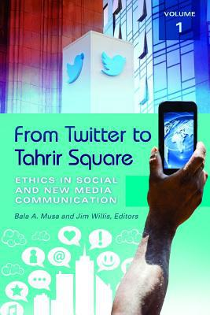
From Twitter to Tahrir Square: Ethics in Social and New Media Communication
by
Bala A. Musa and Jim Willis, Editors
“Social media impacts every aspect of daily life today.”

Slide 4
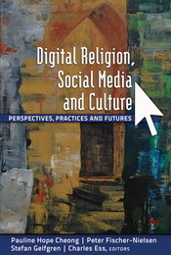
Musa, B. A. & Ahmadu, I. M. (2012). New media, Wikifaith, and church brandversation: A media ecology perspective. In P. H. Cheong, P. Fisher-Nielsen, S. Gefgren & C. Ess (Eds.), Digital religion, social media and culture: Perspectives, practices, and futures (pp. 63-80). New York: Peter Lang.

Slide 5
Social Media
Many-to-many digital technology that allows for sharing of information among participants.
Emerging and evolving communication platform.
Includes Facebook, Twitter, Instagram, Tumblr, Blogs, Linked-In, etc.

Slide 6

Christian Church
Community of followers of Jesus Christ.
Refers to local and universal.
Emphasis on institutional church.

Slide 7
Church and Media
Christianity and all religions exist because of communication media – from oramedia to social (multi)media.
The church has been an early adopter of “new” media -- from the papyrus, to the ancient scrolls, the Gutenberg Press, broadcast media, to social media.
Church leaders must have “Followers.”

Slide 8
Social Media and the Church
Media technology are not completely pliable or neutral in the hands of their users (Ellul, 1967; Postman, 1992; Christians, 1997, 2002; .
Users bend technology and technology bend users.

Slide 9
Social Media Communication Models
Web 1.0
  Action (Transfer/Transmission/Mechanistic)
  Interaction (Exchange/Humanistic)
Web 2.0
  Transaction (Immersion/Contextual/Sociological)

Slide 10
Social Media and the Church
Expansion – Reaching a wider audience.
Extension – Reaching outside the walls of sanctuary.
Substitution – Alternative to going to church.
Connection – To other members.
Reinforcement – Revisiting and reminding.
Engaging – The public discourse.

Slide 11

Virtual Churches and Worshippers
Virtual Churches
Virtual Church Media

Slide 12
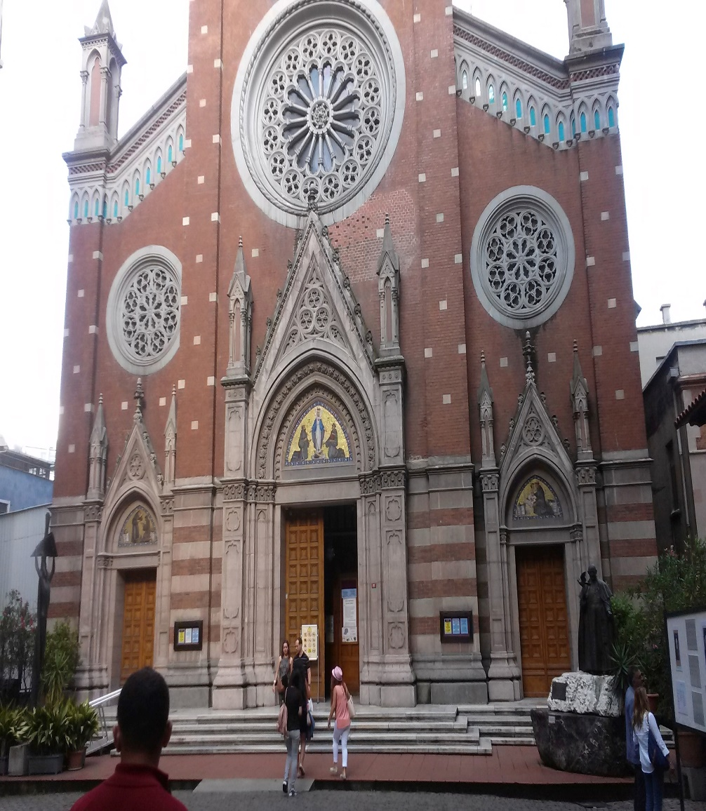
Identity and Church Community
Stronger Connection
More Loose Connection
Global Reach
Accountability
Inchoate identity
Inchoate theology
Inchoate leadership

Slide 13
Church Branding
Family: Welcoming and inclusive.
Pilgrim – The Church on the Information Superhighway
Army – Arming, equipping and commissioning.
Vineyard: Growing, Nurturing, and Thriving
Care Center – Counseling, supporting, and comforting.

Slide 14

Cyberchurch Spirituality and Experience
Faith as personal and collective
Prayer
Worship
Communion
Devotion
Discipleship
Ecumenism
Eclecticism

Slide 15
Reflections
How is the medium impacting the message?
Will new media dictate the church’s tune or will the church dictate new media’s tune?
What happens when Avatars worship and pray on our behalf?
Will social media free or constrain the church?

Slide 16
Q & A

Slide 17
Reference
Christians, C. G. (1997). Technology and the triadic theories of mediation. In S. M. Hoover & K. Lundy (Eds.), Rethinking media, religion and culture (pp. 66-67). London, England: Sage Publications.
Christians, C. G. (2002). Religious perspectives on communication technology. Journal of Media & Religion 1(1), 37-47.
Ellul, J (1967). The technological society. New York, NY: Vintage Books.
Scribner, H. (2013). How social and digital media are change #religion. National. Deseret News. http://national.deseretnews.com/article/464/how-social-and-digital-media-are-changing-religion.html
McLuhan. M. (1994). Understanding media: The extensions of man. Cambridge, MA: MIT Press.
Musa, B. A. & Ahmadu, I. M. (2012). New media, Wikifaith and church brandversation: A media ecology perpestive. In P. H. Cheong, P. Fischer-Nielsen, Stefan Gelfgren & C Ess (Eds.), Digital religion, social media and culture: Perspectives, practices, and futures (pp. 63-80). New York, NY: Peter Lang.
Musa, B. A. & Willis, J. (Eds.). (2014). From twitter to Tahrir square: Ethics in social and new media communication. Santa Barbara, CA: Praeger.
Postman, N. (1992). Technopoly: The surrender of culture to technology. New York, NY: Vintage Books.

