Slide 1

1. Type questions into GoToTraining “chat” text box; they will be addressed during the Q&A after the presentation.
2. Consider joining CCSN (www.theccsn.com). It’s free.
3. Read about member benefits:
http://www.theccsn.com/about/membership-benefits/
3. Contact the Network Administrator with additional questions: administrator@theccsn.com
4. Learn about upcoming webinars: http://www.theccsn.com/category/webinars/webinars-upcoming/

Slide 2
What Can we learn about the intersection of Technology & Faith through a
Networked Theology
Heidi Campbell, Assoc Professor Texas A&M University

Slide 3
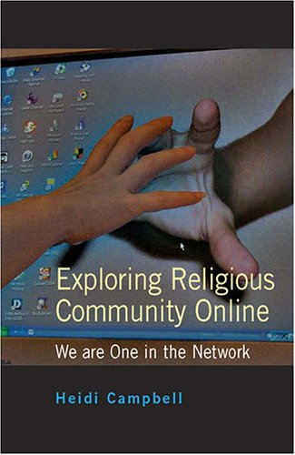
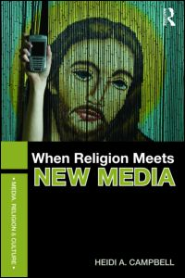
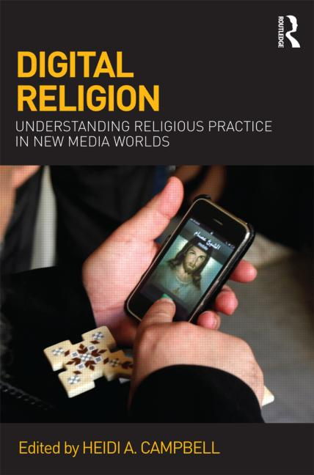
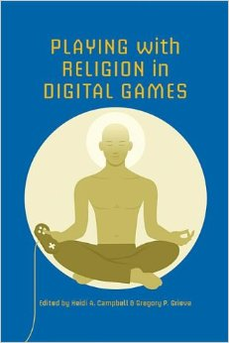
Studying Digital Religion

Slide 4
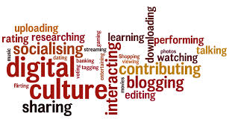
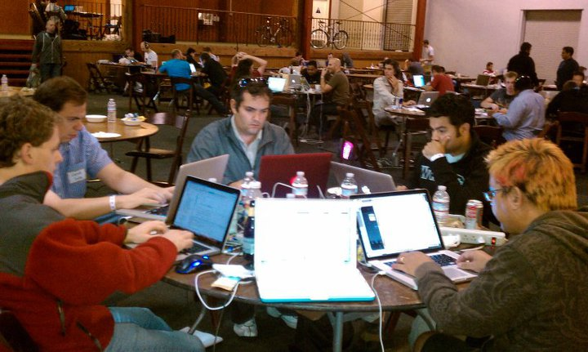

Slide 5
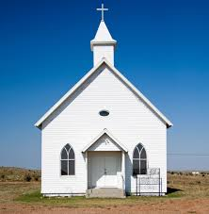
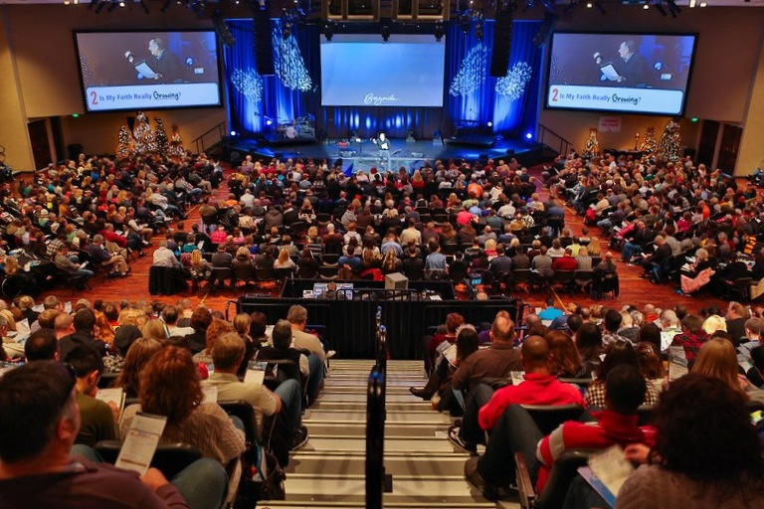
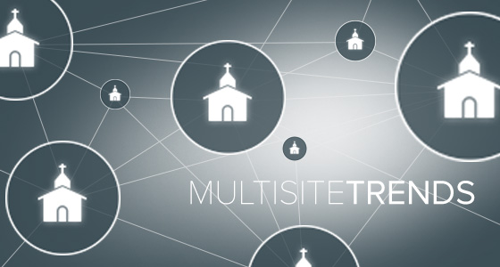
Changes in Religion

Slide 6
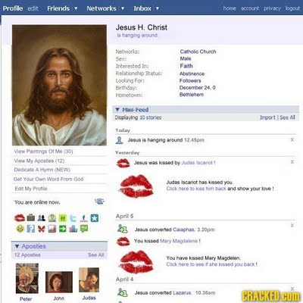
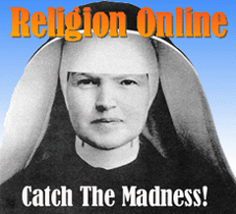
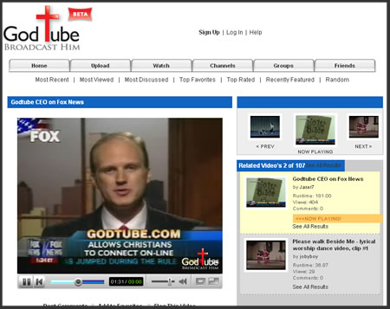
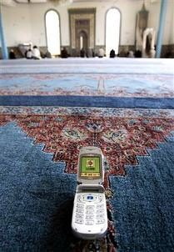
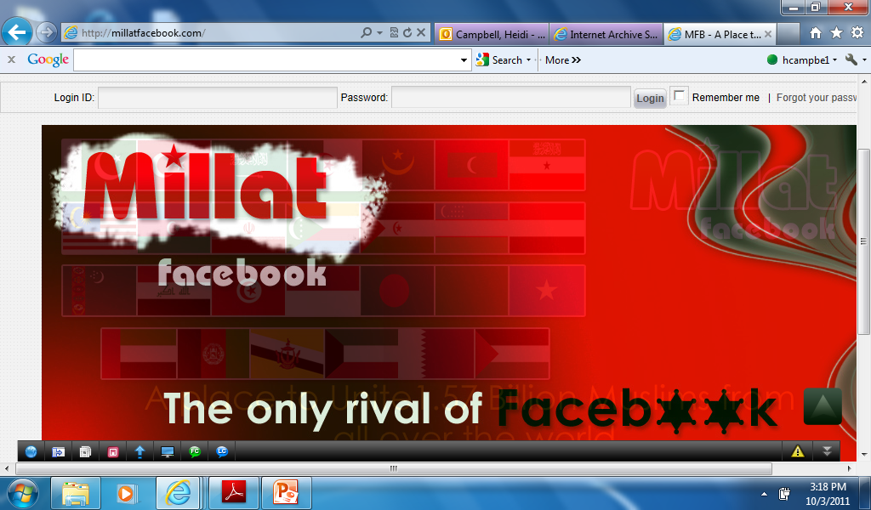
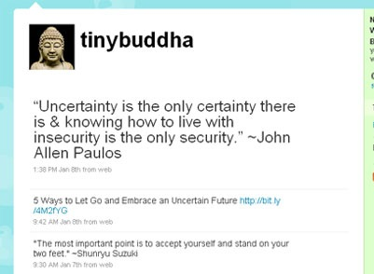
Rise of Digital Religion

Slide 7
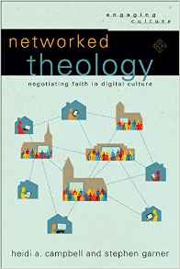
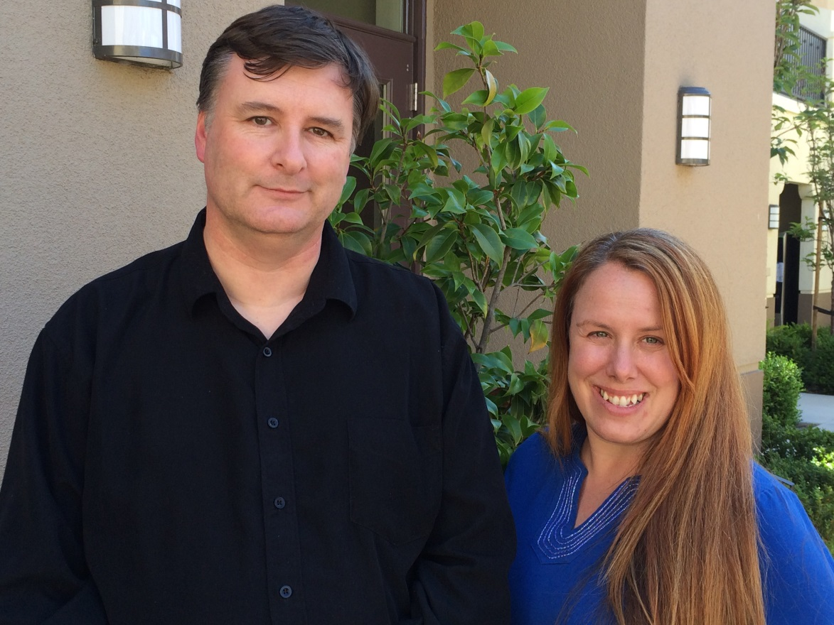
Towards a Networked Theology
A Media Scholar & Theologian in Conversation on Digital Media & Culture

Slide 8
Towards a Networked Theology
Theology of Technology 101
New Media Theory 101
Considering Networked Religion
Merging the Network with Theology
Developing a Faith-Based Community Response
Reflecting Appropriate Theological Engagement with Digital Media

Slide 9
Towards a Networked Theology
If there's one single thing that characterizes emerging forms of church across the western world it's that they are networked.
Steve Collins,
“Network Church” (2004)

Slide 10
Towards a Networked Theology
Network as…a metaphor & lived reality; a system of dynamic & interconnected social relations
Theology as… “faith seeking understanding”; dialogue between scripture, Christian tradition & culture in which we find ourselves (digital culture, network society)

Slide 11
Towards a Networked Theology
Networked Theology as…theology and media in dialogue; a framework for personal & communal reflection on how faith can be understood & ethically practiced in digital culture

Slide 12
Towards a Networked Theology
  Challenge of Religion reflecting conditions of Network Society
    Social relations increasingly decentralized & interconnected through social-technical infrastructure (Castells 1996)
    loosening & re-presentation of traditional boundaries & practices

Slide 13
Characteristics of Networked Religion
* Convergent Practice
  - personalized blending of information & rituals
* Networked Community
  - loosely-bounded social networks
Multi-site Reality
  - embedded online-offline connections
* Storied Identity
  -fluid & dynamic identity construction
* Shifting Authority
  - Simultaneous empowerment & challenge of authority
Notes:
-bl

Slide 14
Characteristics of Networked Religion
* Convergent Practice
  - personalized blending of information & rituals
* Networked Community
  - loosely-bounded social networks
Multi-site Reality
  - embedded online-offline connections
* Storied Identity
  -fluid & dynamic identity construction
* Shifting Authority
  - Simultaneous empowerment & challenge of authority
Notes:
-bl

Slide 15
Networked Community
Supporting networked forms of community
* Online religious communities function as loose social networks with varying levels of religious affiliation and commitment
* Religious users affiliate with multiple social networks simultaneously, with varying depth & highly personalized engagement

Slide 16
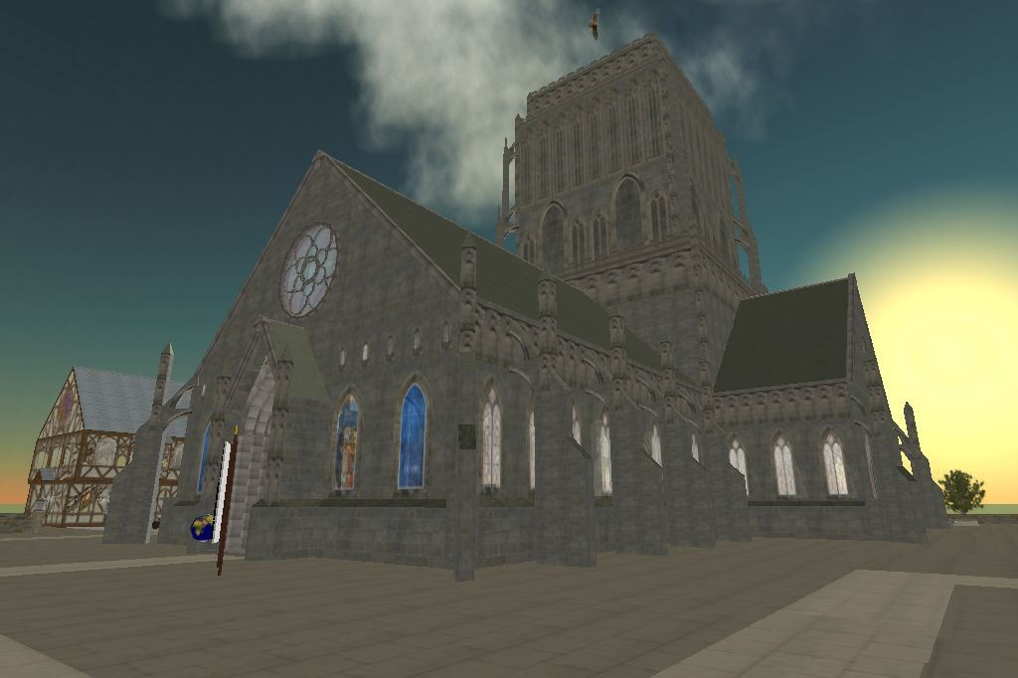
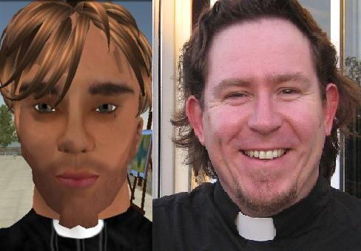
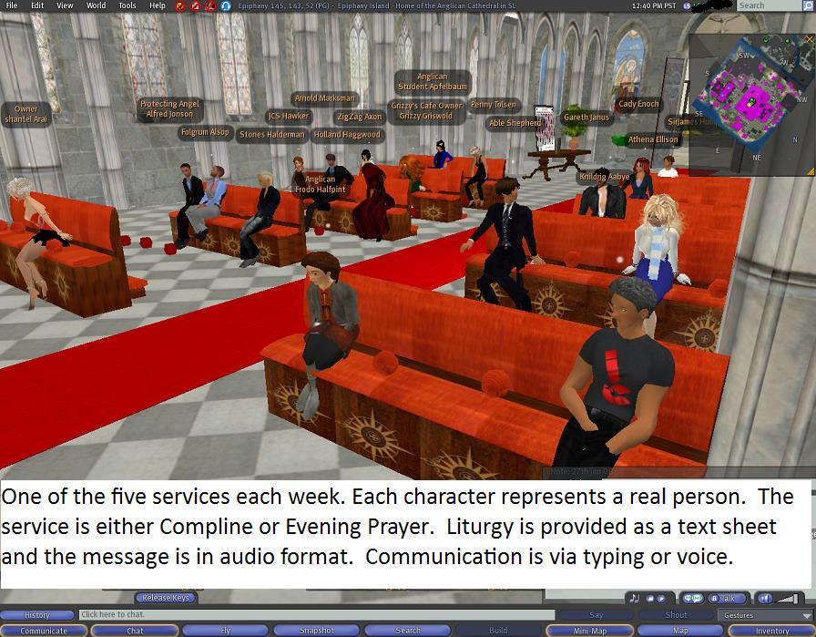
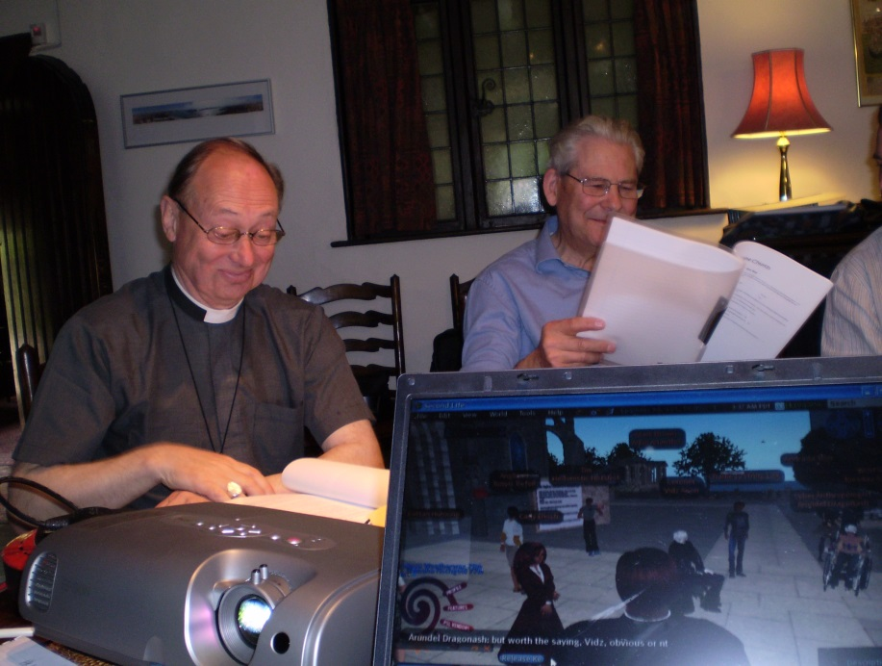
Anglican Cathedral in Second Life

Slide 17
Multi-Site Reality
Recognizing the interconnectedness or embeddedness of online and offline contexts
  * Religious spaces online are consciously & unconsciously imprinted by users’ offline values
  * Religious users and innovators seek to integrate spaces and create ideological as well as practical overlaps

Slide 18
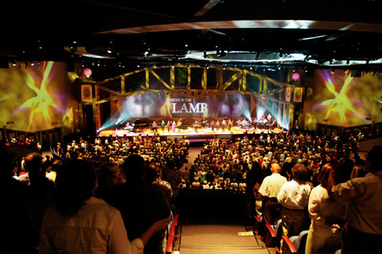
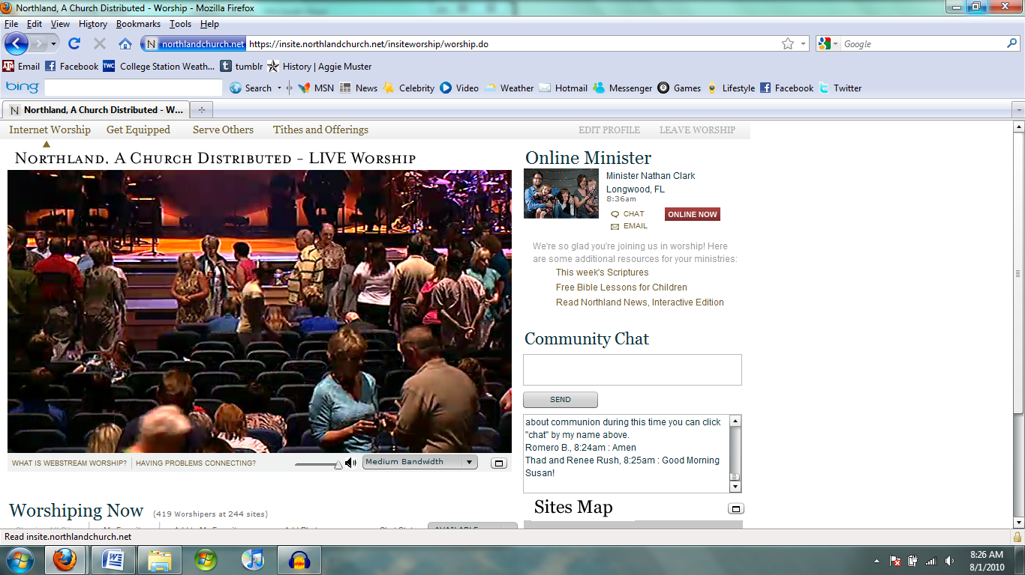
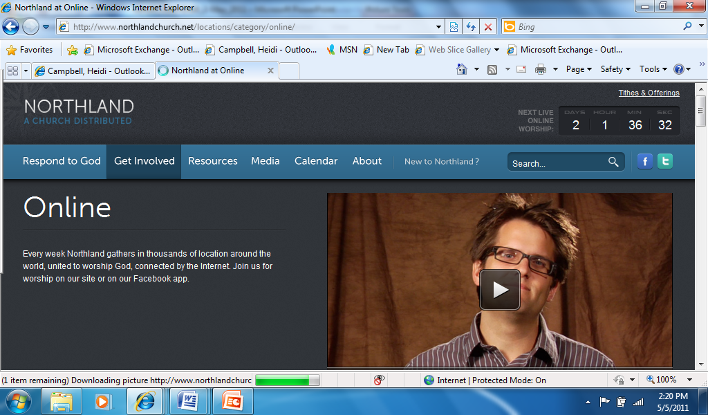

Slide 19
Religion IN A NETWORK SOCIETY IS…
  (1) re-conceived through networked negotiations
  (2) traditional narratives, practices & structures become dynamic &transitional as they adapt to network society

Slide 20
Questions for a Networked ChurcH
Who is my neighbor…?
Where is my neighbor…?
How do I treat my neighbor…?
  …in a digital world

Slide 21
Questions for a Networked ChurcH
Who is my neighbor…?
Where is my neighbor…?
How do I treat my neighbor…?
  …in a digital world

Slide 22
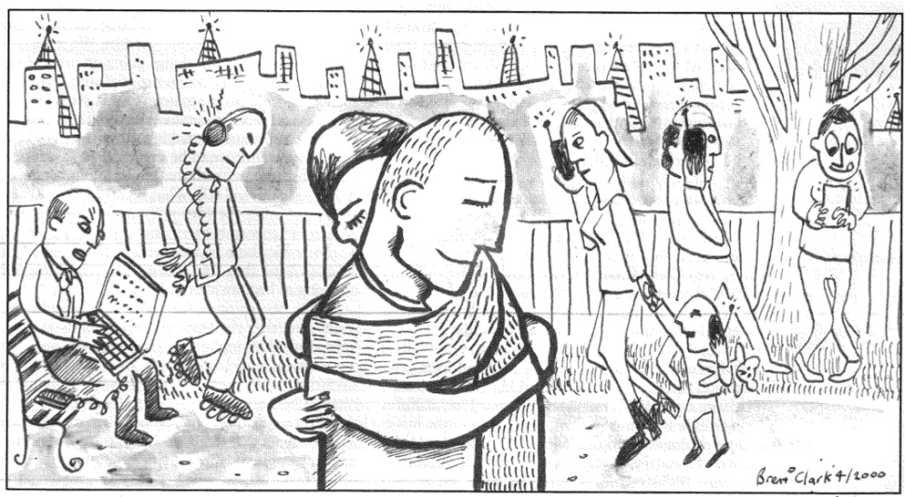
Where is my Neighbor?
Neighborhood is how we locate ourselves in the world, where we encounter God & experience the community of faith
  Digital environments become neighborhoods where we also find a sense of identity, encounter God, find communal reflection a place where we can live & love the other.

Slide 23
Where is my Neighbor in the Network?
Recognize the Internet informs who constitute our neighbors
Recognize our neighbors are found both online and offline
Expect to meet God in digital spaces
]

Slide 24
Towards a Networked Theology
Networked Theology requires expanding our notions of neighbor & neighborhood when seeking to act faithfully & justly online and offline

Slide 25

Question & Answers
Email: heidic@tamu.edu
Web: Network for New Media, Religion and Digital Culture Studies
  http://digitalreligion.tamu.edu

