Slide 1

1. Type questions into GoToTraining “chat” text box; they will be addressed during the Q&A after the presentation.
2. Consider joining the CCSN. Read about member benefits: http://theccsn.com/membership-benefits/
3. Contact the Network Administrator with additional questions: administrator@theccsn.com
4. Learn about upcoming webinars: http://theccsn.com/upcoming-webinars/

Slide 2
The electronic church in the digital age
Cultural impacts of
evangelical mass media
Mark Ward Sr
U of Houston-Victoria

Slide 3
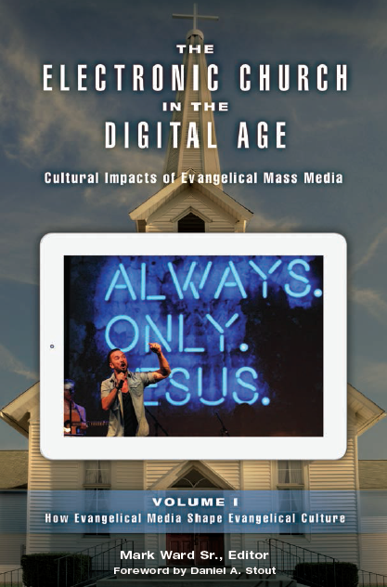
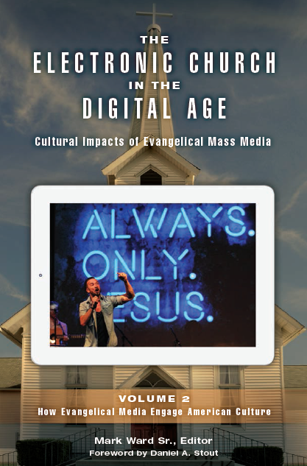

Slide 4
citations
Ward, M., Sr. (2016). The electronic church in the digital age: Cultural impacts of evangelical mass media, Vol. 1: How evangelical media shape evangelical culture. Santa Barbara, CA: Praeger
Ward, M., Sr. (2016). The electronic church in the digital age: Cultural impacts of evangelical mass media, Vol. 1: How evangelical media shape evangelical culture. Santa Barbara, CA: Praeger

Slide 5
MAIN POINTS
Foundations for religious comm research
My research agenda
Where media and religion fit in
‘The Electronic Church’ project

Slide 6
1. foundations

Slide 7
1. FOUNDATIONS
WHAT ARE RELIGIONS?
not a feature of natural world
are historical vs naturally occurring
thus are social realities

Slide 8
1. FOUNDATIONS
SOME SOCIAL REALITIES IN RELIGION
institutions (religions, movements, denominations)
organizations (congregations, parachurches)
communities (small groups, online, genre audiences)

Slide 9
1. FOUNDATIONS
4 QUESTIONS ABOUT SOCIAL REALITIES
Objective or subjective existence?
Known thru observation or experience?
Understood thru science or participation?
Determined by environment or free will?

Slide 10
1. FOUNDATIONS
4 QUESTIONS
2 Determinants
1) Are social realities objective or subjective?
2) Do social realities tend to order or conflict?

Slide 11
 | BELIEF ABOUT SOCIAL LIFE ORDER
BELIEF ABOUT SOCIAL REALITY OBJECTIVE | FUNCTIONAL | INTERPRETIVE | BELIEF ABOUT SOCIAL REALITY SUBJECTIVE
 | CRITICAL | POSTMODERN
 | CONFLICT BELIEF ABOUT SOCIAL LIFE

Slide 12
1. FOUNDATIONS
FUNCTIONAL APPROACH
ontology social realities have autonomous existence
epistemology social realities known by observation
axiology only observable phenomena worth knowing
communication performs functions

Slide 13
1. FOUNDATIONS
EXAMPLES OF FUNCTIONAL APPROACH
socialization of new pastors (Gordon 1996)
expressing dissent in church (Garner & Wargo 2009)
pastoral messages on media (Armfield et al 2006)

Slide 14
1. FOUNDATIONS
INTERPRETIVE APPROACH
ontology social realities exist in relation to subjectivities
epistemology social realities known by interpretation
axiology unobservable mindsets worth knowing
communication constructs shared reality

Slide 15
1. FOUNDATIONS
EXAMPLES OF INTERPRETIVE APPROACH
members’ identification w/ church (McNamee 2011)
nuns’ identification w/ order (Hoffman 2007)
stories told by parish staff (Coopman & Meidlinger 2000)
cognitive-cultural model of tithing (Ward 2015)

Slide 16
1. FOUNDATIONS
CRITICAL APPROACH
ontology social realities have autonomous existence
epistemology social realities known by ideology critique
axiology marginalized standpoints worth knowing
communication distorts realities

Slide 17
1. FOUNDATIONS
EXAMPLES OF CRITICAL APPROACH
house-church egalitarianism (Leeman 2006)
church’s structural racism (Jenkins & Dillon 2012)
binaries in evangelical media (Ward 2014)

Slide 18
1. FOUNDATIONS
POSTMODERN APPROACH
ontology social realities have subjective existence
epistemology discourses known by deconstruction
axiology multiple realities worth knowing
communication means for discursive contestation

Slide 19
1. FOUNDATIONS
EXAMPLES OF POSTMODERN APPROACH
fragmentation of political religion (Ward 2014)
no studies of congregations as other than stable and normative (vs decentered and fragmented)

Slide 20
2. MY AGENDA

Slide 21
2. MY AGENDA
KEY EXPERIENCES
came of age within evangelicalism
    conservative evangelical/moderate fundamentalist
started graduate school
    fascinated by speech codes theory and interpretive approach
took opportunity for field work
    200 churches in 17 states over 4 years

Slide 22
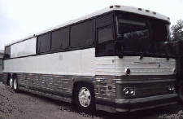
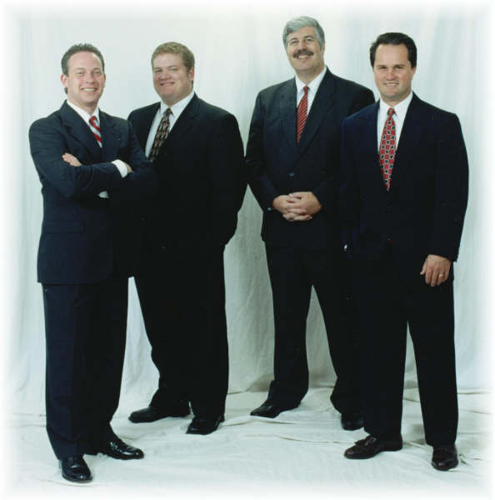

Slide 23
E T I C V I E W | E M I C V I E W
detached observer | normal participant
alien | domestic
cross-cultural | monocultural
typological | taxonomic
absolute | relative
measurable | contrastive
conceptual | discovery

Slide 24
Complete observer
Observer as participant
Participant as observer
Complete participant
OBSERVATION PARTICIPATION

Slide 25
2. MY AGENDA
KEY FINDINGS
spontaneous talk
    evangelicalism as speech community
planned rhetoric
    preaching as leadership communication
structurational processes
    communities of faith as cultures

Slide 26



MACRO-LEVEL PRACTICES
cultural processes
MESO-LEVEL PRACTICES
organized communal life
MICRO-LEVEL PRACTICES
private interactions and enactments

Slide 27
2. MY AGENDA
PUBLICATIONS: MICRO PRACTICES
Ward, M., Sr. (2010). “I was saved at an early age”: An ethnography of fundamentalist speech and cultural performance. Journal of Communication and Religion, 33, 108-34.

Slide 28
2. MY AGENDA
PUBLICATIONS: MESO PRACTICES
Ward, M., Sr. (2015). The PowerPoint and the glory: An ethnography of pulpit media and its organizational impacts. Journal of Media and Religion, 14, 57-77.
Ward, M., Sr. (2009). Fundamentalist differences: Using ethnography of rhetoric to analyze a community of practice. Intercultural Communication Studies, 18, 1-20.

Slide 29
2. MY AGENDA
PUBLICATIONS: MACRO PRACTICES
Ward, M., Sr. (2015). Cognition, culture, and charity: Sociolinguistics and “donor dissonance” in a Baptist denomination. International Journal of Nonprofit and Voluntary Organizations, 26, 574-603.
Ward, M., Sr. (2014). Give the winds a mighty voice: Evangelical culture as radio ecology. Journal of Radio and Audio Media, 21, 115-133.

Slide 30
3. MEDIA & RELIGION

Slide 31
MACRO-LEVEL PRACTICES
cultural processes
MESO-LEVEL PRACTICES
organized communal life
MICRO-LEVEL PRACTICES
private interactions and enactments

Slide 32
3. MEDIA & RELIGION
TWO APPROACHES TO MEDIA THEORY
social interaction view
    media are conduits for information exchange and should be compared to the ideal of face-to-face interaction
social integration view
    media are environments, each with its own properties for people to share rituals and build communities

Slide 33
3. MEDIA & RELIGION
INTERPRETIVE COMMUNITIES
emerge thru shared interp of media ‘text’
communal interp confers validity
validity directs members’ social actions
thus evangelicalism as interp community

Slide 34
4. THE PROJECT

Slide 35
4. THE PROJECT
WHY STUDY ELECTRONIC CHURCH NOW?
religious media are convergent
conglomerates now control these media
media theory has advanced since 1980s
EC remains key evangelical institution
evangelical subculture impacts civic discourse

Slide 36
4. THE PROJECT
OVERVIEW OF ELECTRONIC CHURCH
infrastructure
audience
changes since 1980s

Slide 37
a) Overview: television
12+ major networks
  satellite, cable, over-the-air, multicast
  100 million HH potential reach
50+ nationally syndicated programs
  up to 7 million weekly viewers

Slide 38
a) Overview: radio
3400 stations (20% of US radio)
1600 Internet stations
10 national networks + many regionals
30+ nationally syndicated programs

Slide 39
a) Overview: new media
mobile apps (iPhone, Android)
tablet media (iPad, Kindle)
streaming media (Web, Roku, AppleTV)
console media (Xbox)

Slide 40
b) Overview: audience
1 in 4 US adults identify as evangelical
90% consume evangelical media monthly
1 in 5 US adults consume daily
more than go to church each month

Slide 41
c) Changes in stRucture
1980s: media ownership regulated
1996: Telecom Act deregulates
2000s: Industry consolidation
2000s: Evangelical media conglomerates

Slide 42
c) Changes in scholarship
1980s: research paradigms
  technological
  cultural
1990s-present: research paradigm
  pragmatic (ethnographic/interpretive)

Slide 43
4. THE PROJECT
POSSIBLE APPROACHES
chronological
topical
interpretive

Slide 44
4. THE PROJECT
POSSIBLE APPROACHES
technological (e.g., Postman)
cultural (e.g., Hoover)
interpretive

Slide 45
In my view, the two volumes in this series represent a dramatic turn in media and religion research—for they proceed from a pragmatic perspective that is missing from previous works. The question is not merely “What are issues surrounding the electronic church?” but “How do audiences read it in a cogent way?” Ultimately, these volumes are not about technology. Nor are they an overview of cultural trends. What we have is a work about pragmatics that suggests ways to think about media and community.
—From the foreword by Daniel A. Stout

Slide 46
4. THE PROJECT
DEFINITIONS
evangelical = identifies with movement
evangelical media = produced/consumed by those who identify with movement
electronic church = totality of evangelical mass media enterprise as institution

Slide 47
4. THE PROJECT
THEMES
EC is evangelical social institution
EC is consolidated and convergent
How do evangelicals ‘read’ EC?
How does EC shape identity/community?
Continuities across platforms

Slide 48
narratives
analog
lived experience
digital

Slide 49
4. THE PROJECT
VOLUME 1
How evangelical media shape evangelical culture
VOLUME 2
How evangelical media engage American culture

Slide 50
4. THE PROJECT: VOLUME 1
PART 1: Constructing the evangelical identity
  radio preaching, religious TV apps, multisite churches
PART 2: Constructing the evangelical community
  music radio, televangelism, videogames
PART 3: Constructing the other
  talk radio, religious TV genres, tablet media

Slide 51
4. THE PROJECT: VOLUME 2
PART 1: Engaging American Life
  marriage and family, money, education
PART 2: Engaging American Discourse
  social issues, pluralism, politics
PART 3: Engaging the American Idea
  ‘Christian nation,’ ‘War on Christianity,’ apocalypse

Slide 52
4. THE PROJECT
AUTHOR GUIDELINES
survey actual evangelical media content
analyze content using established theory of media or rhetoric
emphasize how audiences ‘read’ content

Slide 53
4. THE PROJECT
THEORIES
Comm Theory of Identity
Uses and gratifications
Media ecology
Cultural studies
Secondary orality
Grounded theory
Framing theory
Mediational reflexivity
.
Narratology
Media agenda-setting
Mediatization
Hot and cool media
Observational learning
Boundary maintenance
Social rhetoric
Ideology critique

Slide 54
4. THE PROJECT
MEDIA CONTENT
Trinity Broadcasting
The 700 Club
John Hagee
Joel Osteen
Salem Radio Network
American Family Radio
Alliance Defense Fund
Jesus Calling
.
Dave Ramsey Show
Focus on the Family
FamilyLife Today
Dr Dobson’s Family Talk
Insight for Living
Leading the Way
Turning Point
BreakPoint

Slide 55
MACRO-LEVEL PRACTICES
cultural processes
MESO-LEVEL PRACTICES
organized communal life
MICRO-LEVEL PRACTICES
private interactions and enactments

Slide 56
QUESTIONS?

