Slide 1

1. Type questions into GoToTraining “chat” text box for Q&A after presentation.
2. Consider joining CCSN (www.theccsn.com). It’s free.
3. Read about member benefits: http://www.theccsn.com/about/membership-benefits/
3. Contact the Net Admin w/ questions: administrator@theccsn.com
4. Learn about upcoming webinars: http://www.theccsn.com/category/webinars/webinars-upcoming/

Slide 2

Best Communication Practices for Servant Leaders
Notes:
After the CCSN formatted slide an introduction from the both of us
What brought us to this thinking about Servant-Leadership Communication?
Hamstra – first heard the term while working for ministry and continued to hear about this through work, life, and academics
Schultze -

Slide 3
Best Communication Practices for Servant Leaders
Servant Leadership
The Mystery of Communication
Practice One: Listening
Practice Two: Fittingness
Notes:
After the CCSN formatted slide an introduction from each of us.
Chris first says who he is and reviews the four points of this slide as a summary of the presentation. Then he and Q take on the first topic autobiographically – how they got interested in servant leadership and its relationship to communication.
Hamstra – first heard the term while working for a large ministry organization and continued to hear about this through work, life, and academics.
Schultze—Long ago in grad school while reading theology about human caretaking. Augustine.

Slide 4
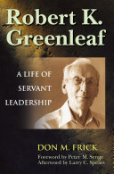
Servant-Leader
“The phrase servant-leader points to a whole that is greater than the sum of the two parts.” (p. 9)
Notes:
Greenleaf argued that a Servant-Leader is a Servant first. This seems to be a rallying point for those who think about and practice Servant-Leadership.
For this discussion would like to start with the idea that the hyphen (-) between the words Servant and Leader are the most important. This is highlighted in Don Frick’s work. When we think about Servant-leaders it is about the whole being better than each separately.
This also develops a unique paradox when thinking and practicing Servant-Leadership and I also see this possible paradox when we think about communication.

Slide 5
“From the Latin communicare, meaning to impart, share, or make common.” (p. 7)
John Durham Peters, Speaking Into the Air (2000)
Communication
Communication
Notes:
A pivotal moment for me in linking together the idea of Servant Leadership with the idea communication came while reading John Durham Peters book ‘Speaking Into the Air.’ Peters defines communication is terms of making common, or sharing.
In other words, communication is shared meaning.
It is not “effect.”
It is not even “agreement.”
It is shared understanding. Shared meaning, co-created by all parties involved.
Servant leaders aim for common understanding rather than self-interested influence. In fact, servant leaders influence primarily through respectful persuasion and especially by modeling virtuous character.

Slide 6

The Mystery of Communication
“Nothing is meaningful until it is related to the hearer’s own experience.” (p. 18)
Notes:
Communication is ultimately a kind of mystery. We can’t force it. We can’t guarantee it. We can try our best for shared meaning, but when such shared understanding happens we experience a kind of gift. It takes at least two people who suspend their differences and seek common understanding. It’s always a matter of dialogue. But it can’t be forced. Communication is an emerging process that takes time.

Slide 7
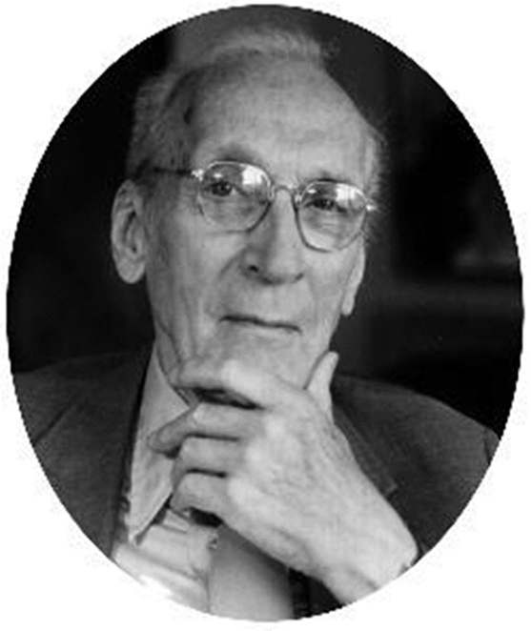
The Importance of Listening
“Listeners learn about people in ways that modify a listener’s attitude, behavior toward others, and the attitudes and behaviors of others.” (p. 303)
Notes:
We spend plenty of time talking about how to speak well, but frequently we forget about the importance of listening. As practitioners of Servant Leadership Communication an important first step is for us to receive messages. This means that we allow ourselves to be influenced. Listening changes us. We think of speaking changing others. We also need to consider listening as transformation of a communicator.

Slide 8
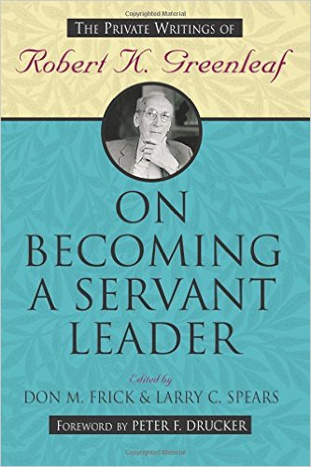
Greenleaf on Listening
Be attentive in outward appearance
and inward alertness
Be constructive in responses
Retain what others express
Refrain from value judgments
Balance facts and feelings
Notes:
Greenleaf’s unpublished book, “The Ethic of Strength,” is included in the edited volume ON BECOMING A SERVANT LEADER. Greenleaf suggests in these essays that great listening starts with 1) – being attentive both in outward appearance and inward alertness. 2) Constructive response, 3) great listeners are trained to retain what is expressed, and 4) they refrain from value judgments, and 5) finally there is a balance of facts and feelings. This is summarizes in Greenleaf’s ‘Servant Leadership’ book that says ‘True listening builds strength in other people”
This quote from Greenleaf for me talks about the great modifying power of effective listening. Interesting that Greenleaf suggests that listening begins internally with ourselves and than works towards our behaviors with others and moves to the thoughts and behaviors of others. All through the simple act of stopping and listening.
An important consideration thought when thinking and practicing Servant-leadership communication is the context or fittingness……

Slide 9
Fittingness
“So much of caring depends upon knowing and interacting with persons in the intimacy of propinquity.” (p. 22)

Slide 10
Fittingness
Serving is loving.
Loving is always particular.
The particular is always contextual—the right fit.
“Servant communication” is always a matter of fit

Slide 11

A Case Study: Worship Technology
How does a church leader know which technologies are fitting for worship—that “fit” with good and right worship?

Slide 12
Selecting a Fitting Medium
Encouraging
Forgiving
Evaluating/Reviewing
Collaborating
Listening (triangulation)
Composing (reflecting, organizing thoughts—communication with self)

Slide 13
Thanks for listening!
Now Dialogue.

