Slide 1

Teaching C. S. Lewis:
Chronicles of a master communicator

Slide 2

My Introduction to C. S. Lewis

Slide 3
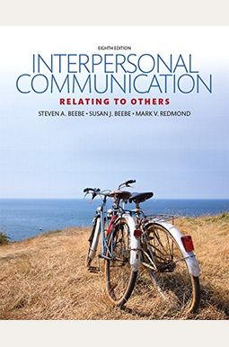
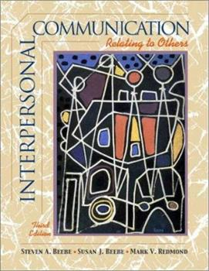
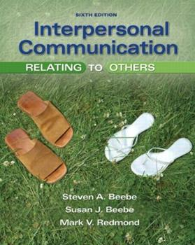
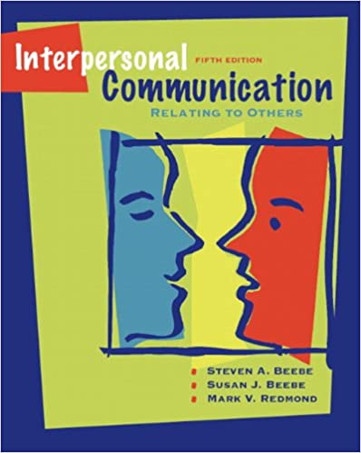
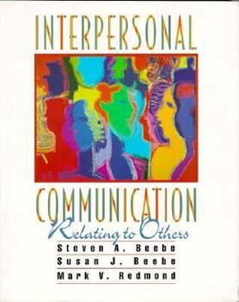
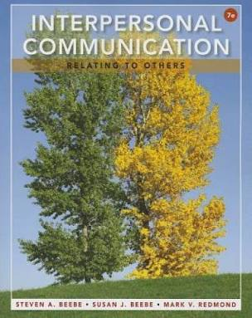
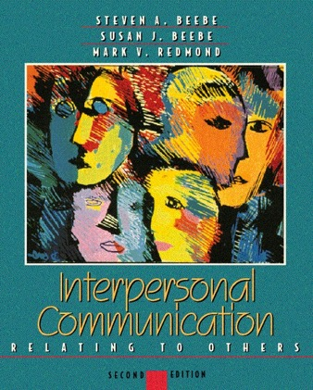
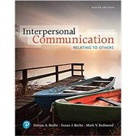


Slide 4


Slide 5


Slide 6


Slide 7


Slide 8
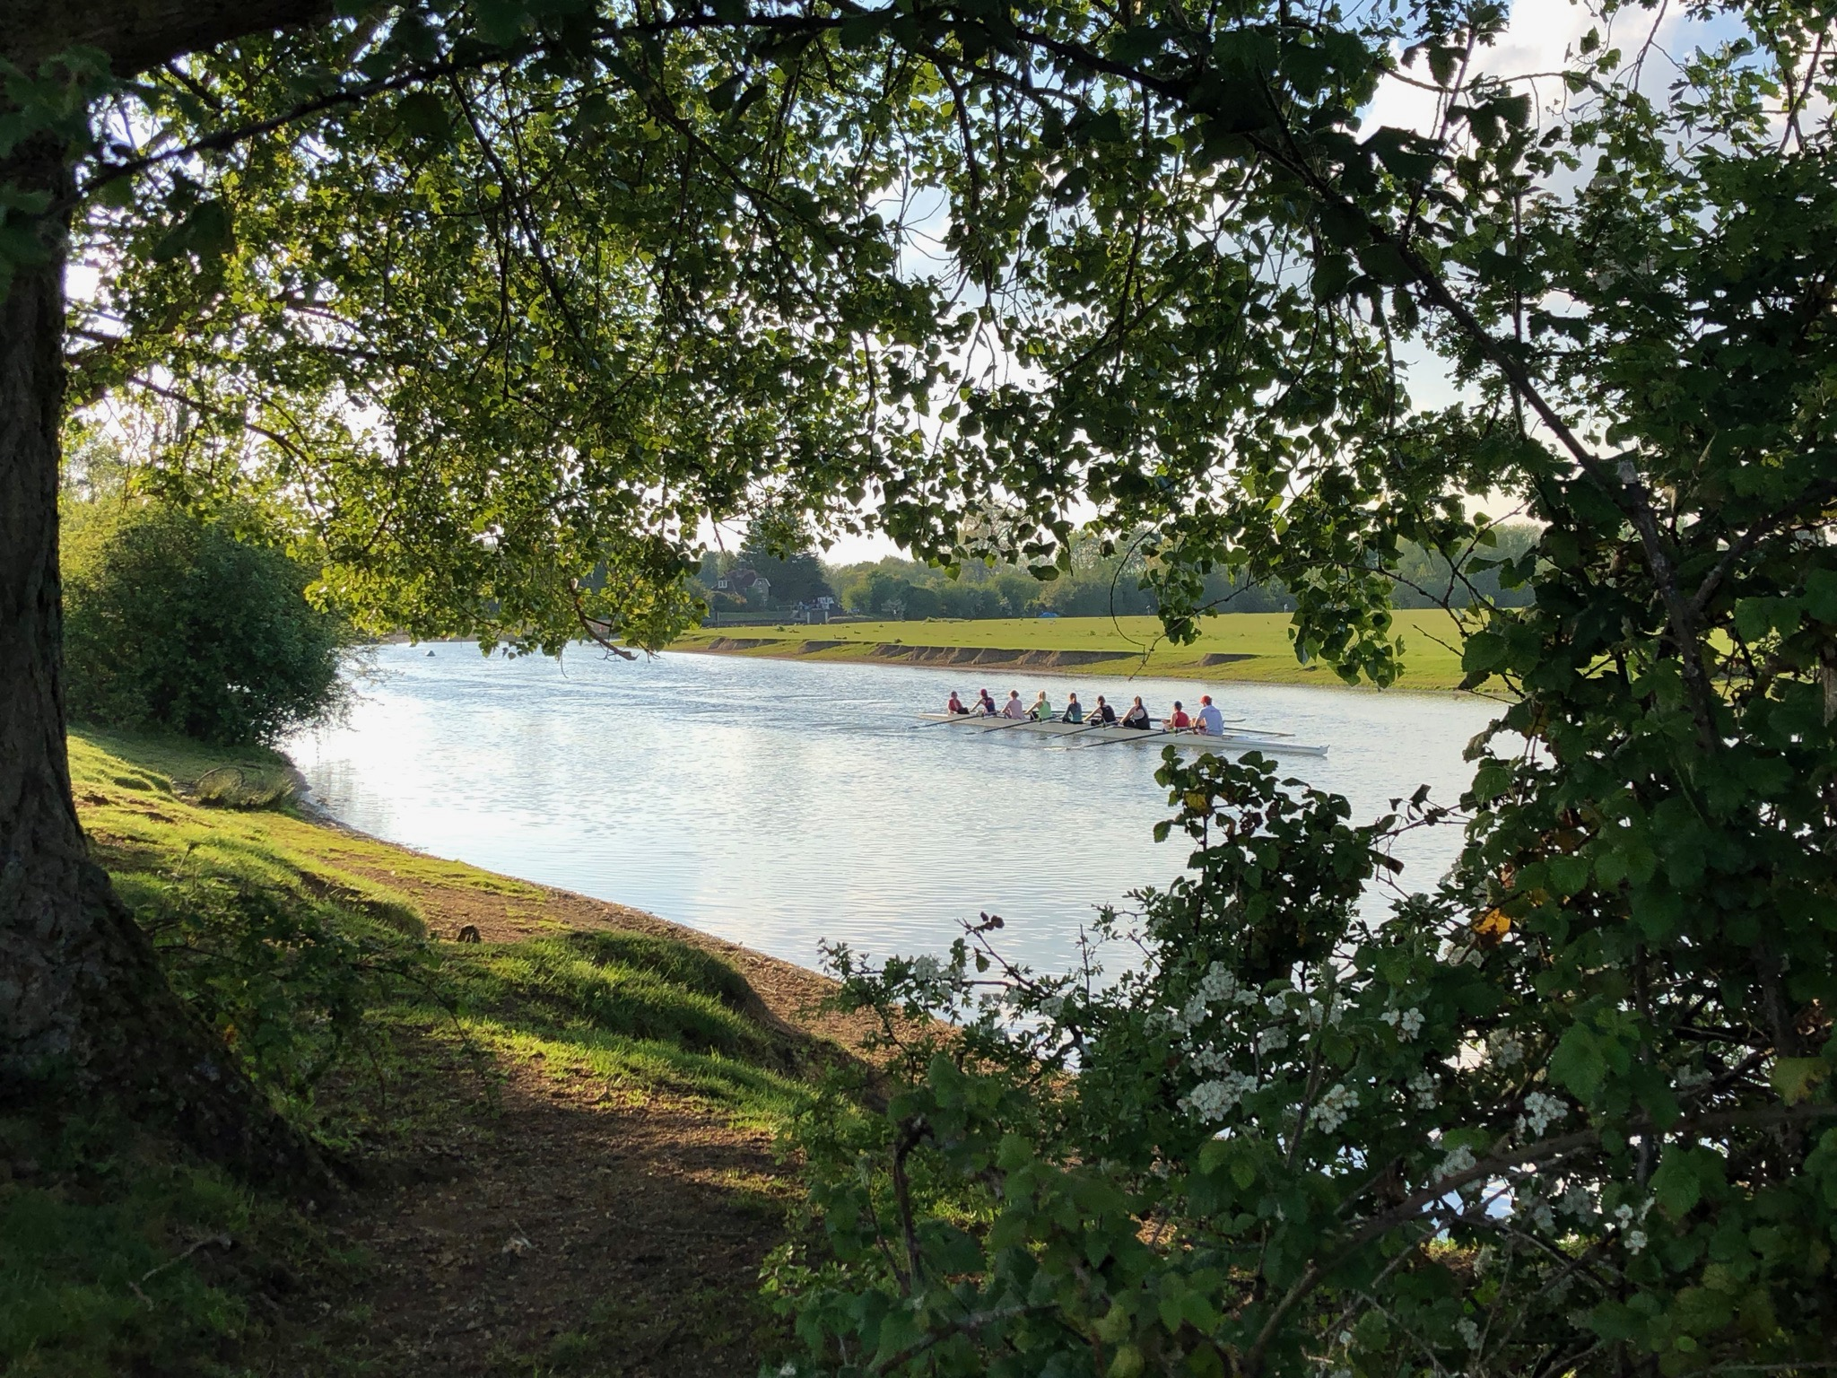

Slide 9


Slide 10


Slide 11


Slide 12


Slide 13


Slide 14
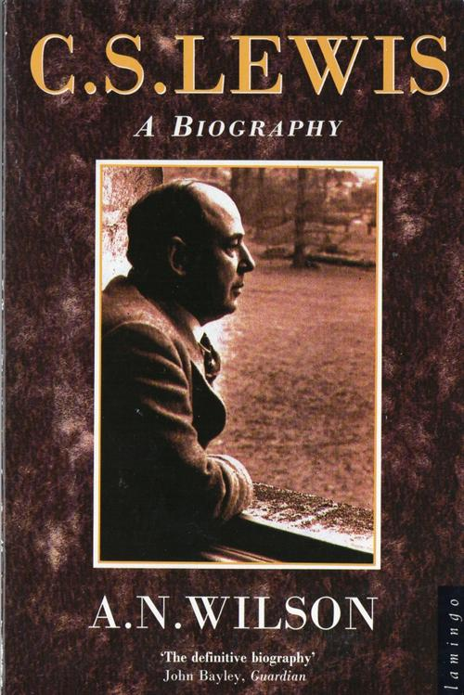

Slide 15


Slide 16


Slide 17
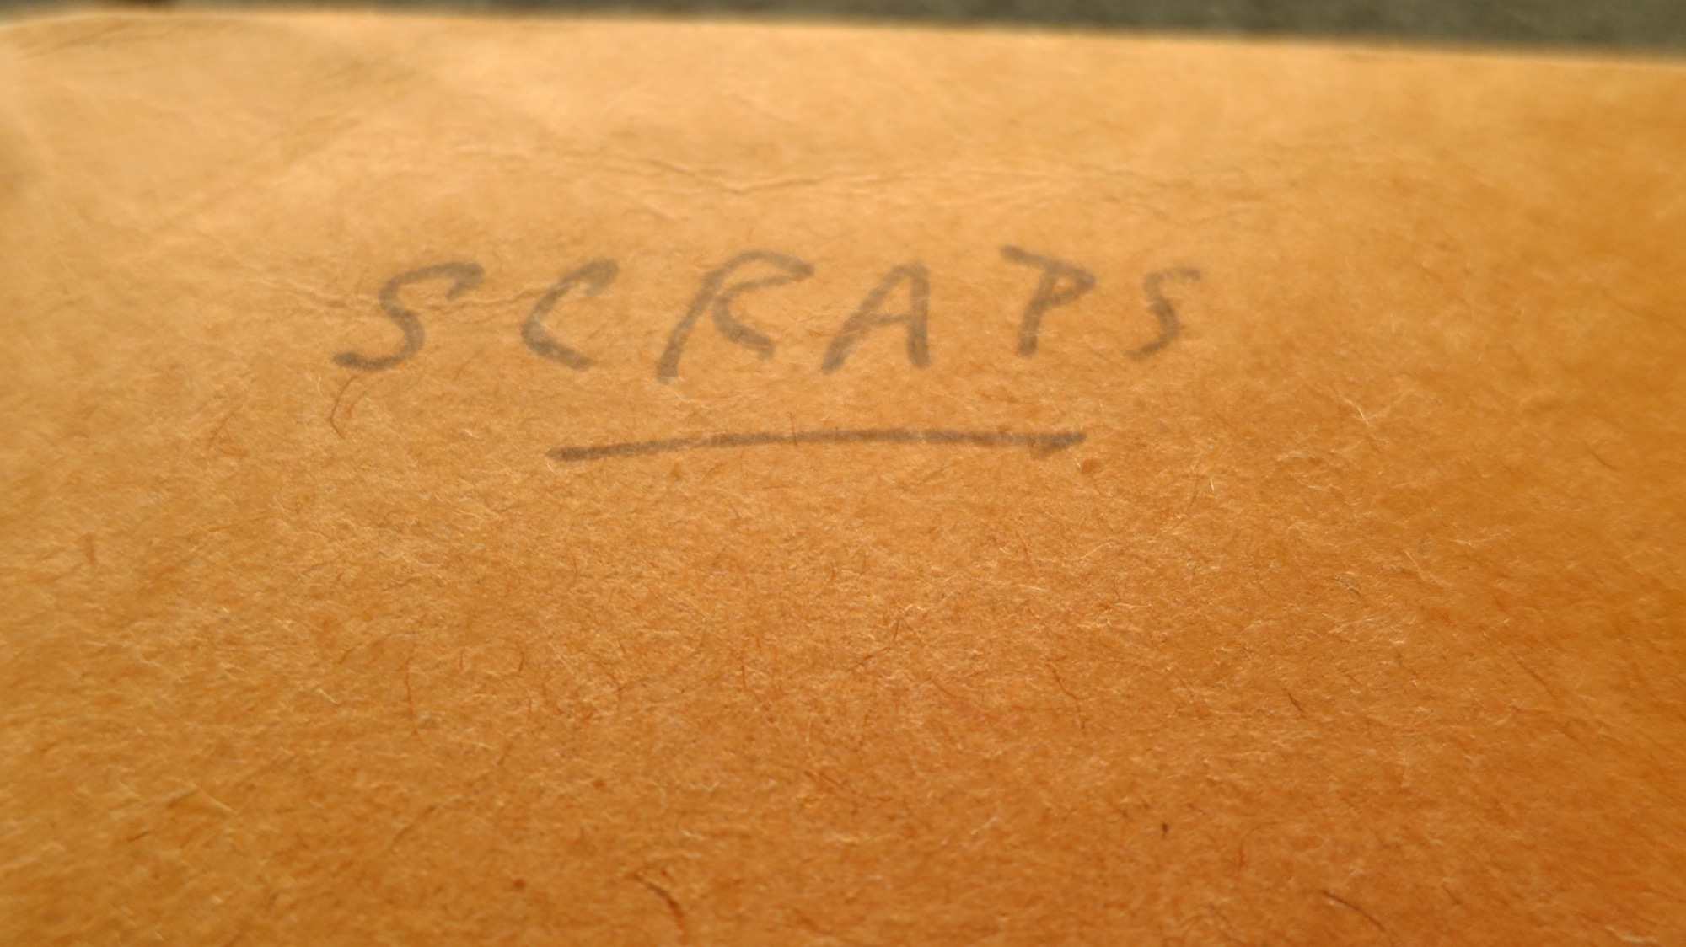

Slide 18
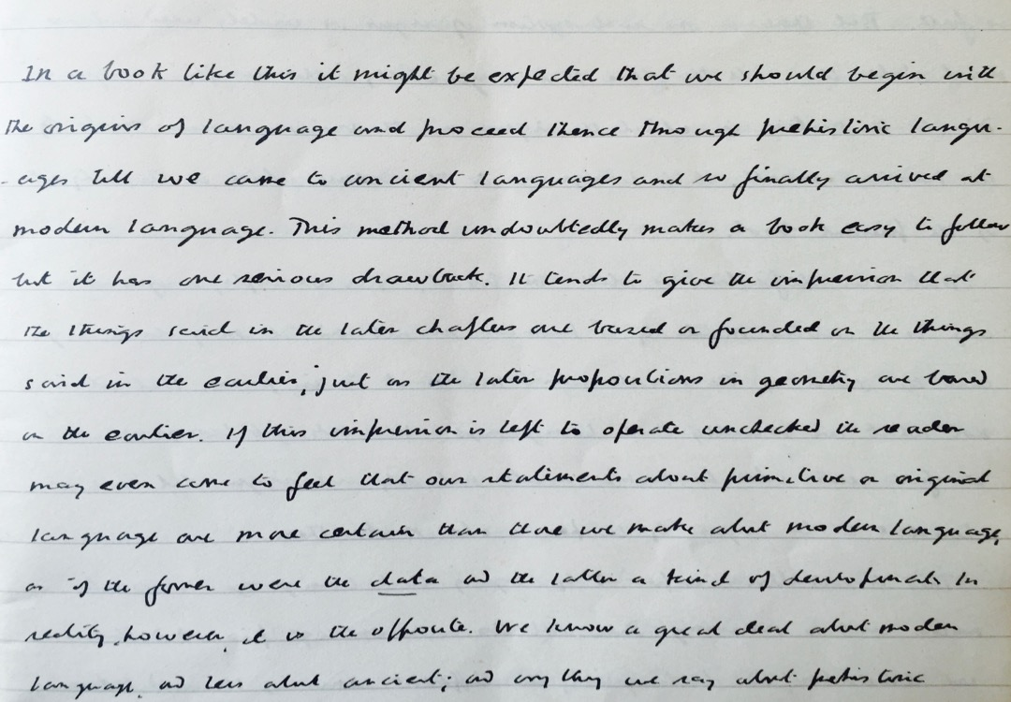

Slide 19
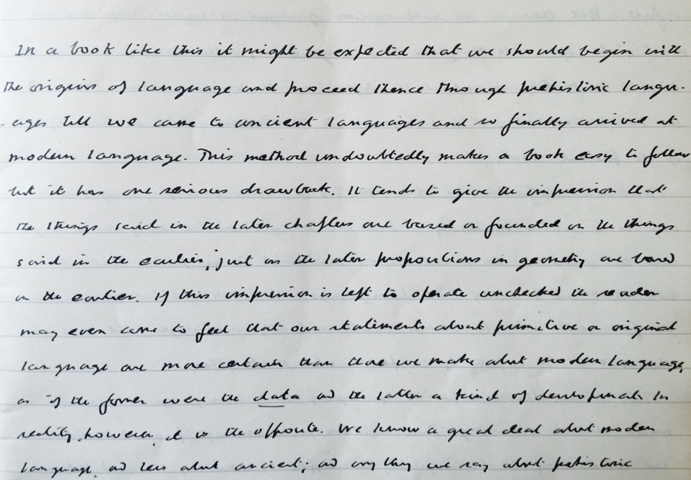
Language and Human Nature
C. S. Lewis & J. R. R. Tolkien

Slide 20
Workshop Overview
Teaching C. S. Lewis at Texas State
Teaching C. S. Lewis at Oxford University
Teaching C. S. Lewis’s Principles of Communication
As presented in C. S. Lewis and the Craft of Communication

Slide 21
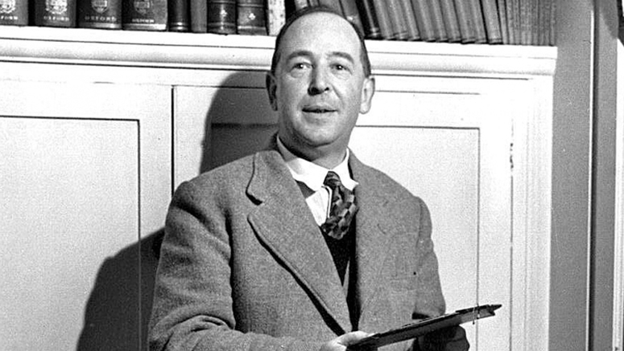

Slide 22
