Slide 1

Teaching C. S. Lewis
Lewis’s Principles of Communication

Slide 2
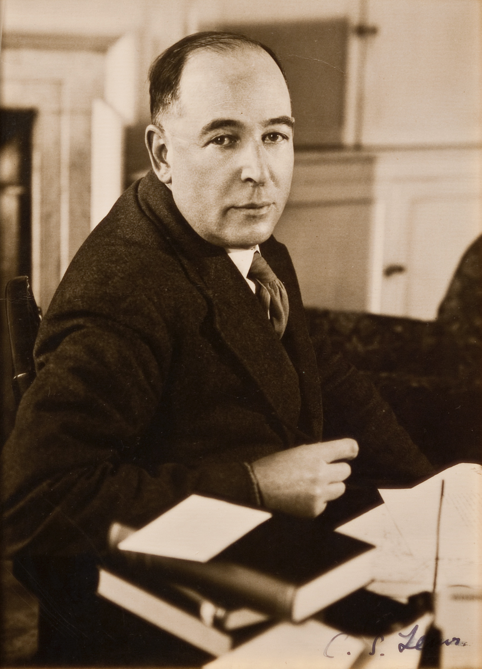
What did C. S. Lewis say
about communication?

Slide 3
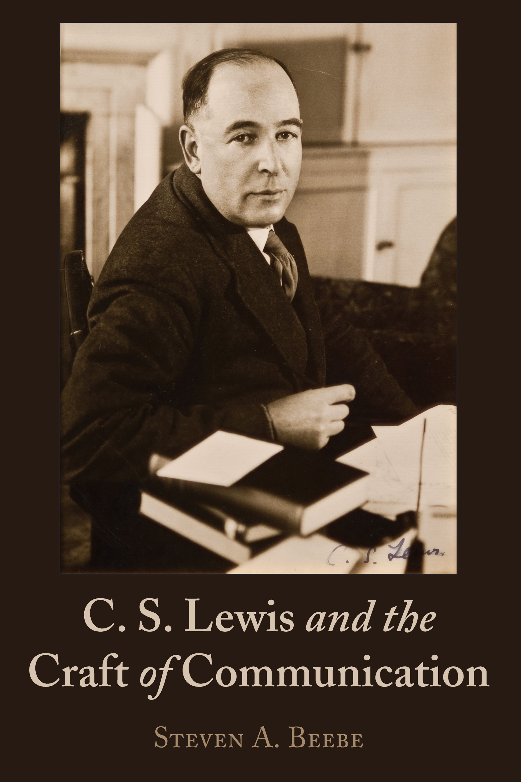

Slide 4
Holistic
Intentional
Transpositional
Evocative
Audience-Centered

Slide 5

HI TEA

Slide 6
Principle One:
Effective communicators are Holistic.

Slide 7
Speaking and Writing

Slide 8
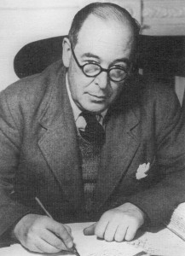
“I use speaker throughout
to cover writer as well.”
-C. S. Lewis, Studies in Words

Slide 9
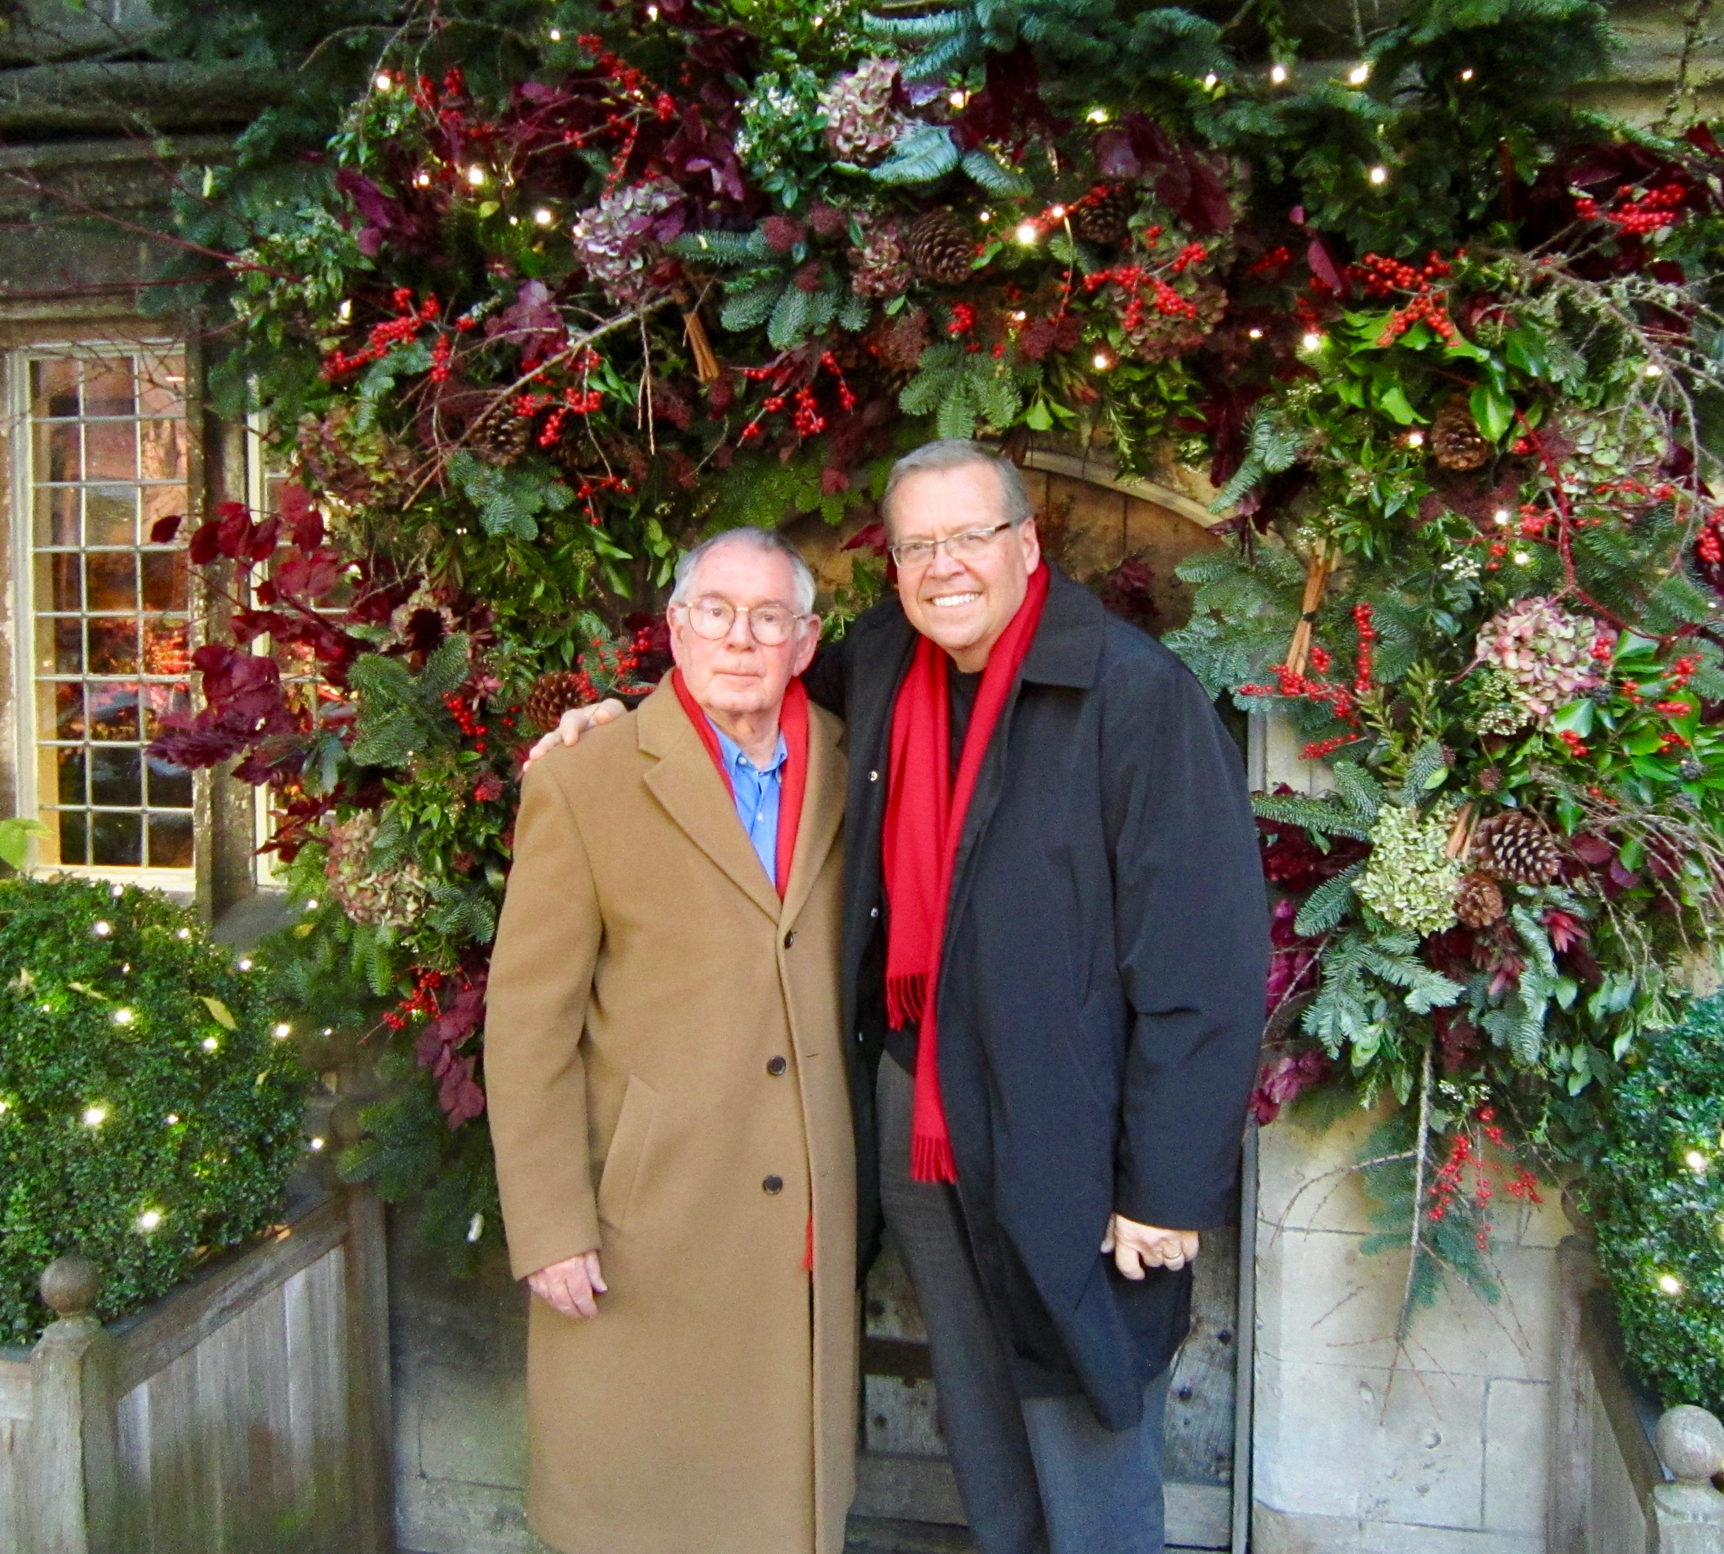
Walter Hooper (1931-2020)
Secretary to C. S. Lewis (1963)
Literary executor to the C. S. Lewis Estate
Editor, more than 30 volumes of Lewis’s work

Slide 10
“When Lewis dictated
letters to me, he always
had me read them aloud
afterwards. He told me that
in writing letters, as well as
books, he always
‘whispered the words
aloud. . .

Slide 11
. . . Pausing to dip the pen in an inkwell provided exactly the rhythm needed. ‘It’s important to please the ear,’ he said, ‘as it is the eye.”

Slide 12
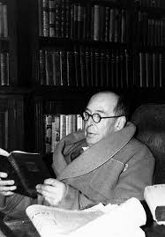
“Always write (and read) with the ear, not the eye. You should hear every sentence you write as if it was being read aloud or spoken.
If it does not sound nice, try again.”
-C. S. Lewis

Slide 13
Reason and Imagination

Slide 14
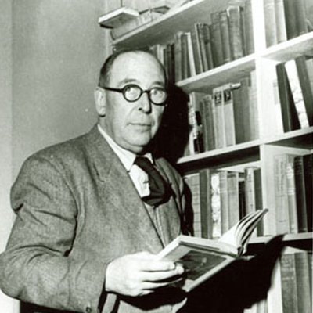
“. . . on the one hand a deep vivid imagination and on the other a profoundly analytical mind.”
-Clyde Kilby

Slide 15

“The two strands that run through C. S. Lewis’s books are ‘logic’ and ‘romance’ . . .”
-Chad Walsh

Slide 16
Rhetoric, Dialectic, and the Poetic

Slide 17
Rhetoric: Discovering the available
means of persuasion
Dialectic: The art of disputation
Poetic: Imaginative literature
whether prose or verse

Slide 18
Principle Two:
Effective communicators are
Intentional

Slide 19
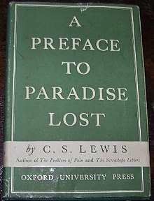
“The first Qualification for judging any piece of workmanship from a corkscrew to a cathedral is to know what it is—what it was intended to do and how it is meant to be used.”
-C.S. Lewis, A Preface to Paradise Lost

Slide 20
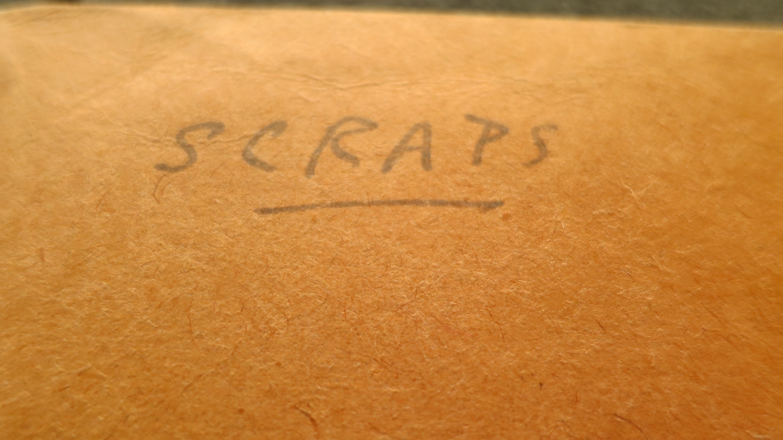
“. . . language . . . intended to be signs by the person who makes them.”
-C. S. Lewis, Language and Human Nature

Slide 21
“. . . language is vocal noise with a meaning.”
-C. S. Lewis, Language and Human Nature

Slide 22

“The way for a person to develop a style is (a) to know exactly what he wants to say, and (b) to be sure he is saying exactly that . . . I sometimes think that writing is like driving sheep down a road. If there is any gate open to the left or the right the readers will most certainly go into it.”
-C. S. Lewis, God in the Dock

Slide 23
“In the very process of eliminating from your matter all that is technical, learned or allusive, you will discover, perhaps for the first time, the true value of learned language: namely, brevity.”
- C. S. Lewis, God in the Dock

Slide 24
Principle Three:
Effective communicators are Transpositional

Slide 25
Translation: A prelude to
Transposition.

Slide 26
“My task is simply that of a translator.”
-C. S. Lewis, “Rejoinder to Dr. Pittenger”

Slide 27
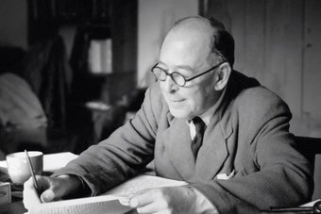
“I have come to the conviction that if you
cannot translate your thoughts
into uneducated language, then
your thoughts were confused.”
-C. S. Lewis, “Christian Apologetics”

Slide 28
Transposition:
Communicating an emotionally rich experience (often through the use of metaphor, allegory, simile, comparison, story or myth)
to help others discover the meaning of the experience.

Slide 29
Transposition:
Higher to lower
Richer to poorer
Ineffable to effable

Slide 30
“If you are making a piano version of a piece originally scored for an orchestra, then the same piano notes which represent flutes
in one passage
must also represent violins in another.”
-C. S. Lewis, Transposition and Other Addresses

Slide 31
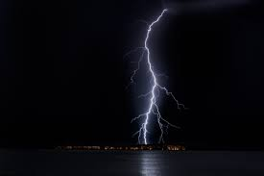
Review: The Lord of the Rings
“Like lightening out of a clear sky.”
--C. S. Lewis

Slide 32
“. . . the concept of Transposition may have some contribution to make to the theology—or at least the philosophy—of the Incarnation.”

Slide 33
The Technique of Transposition:
Visual Metaphor

Slide 34
Becoming a Christian is like . . .
Taking fuel on board
Laying down your rebel arms and surrendering
Turning full speed astern
Learning to walk
A drowning man clutching at a rescuer’s hand
A tin soldier or statue become alive
Waking after a long sleep
Emerging from the womb
A horse turning into a Pegasus
Coming in out of the wind
Coming around from anesthetic
Going home
From: Mere Christianity

Slide 35
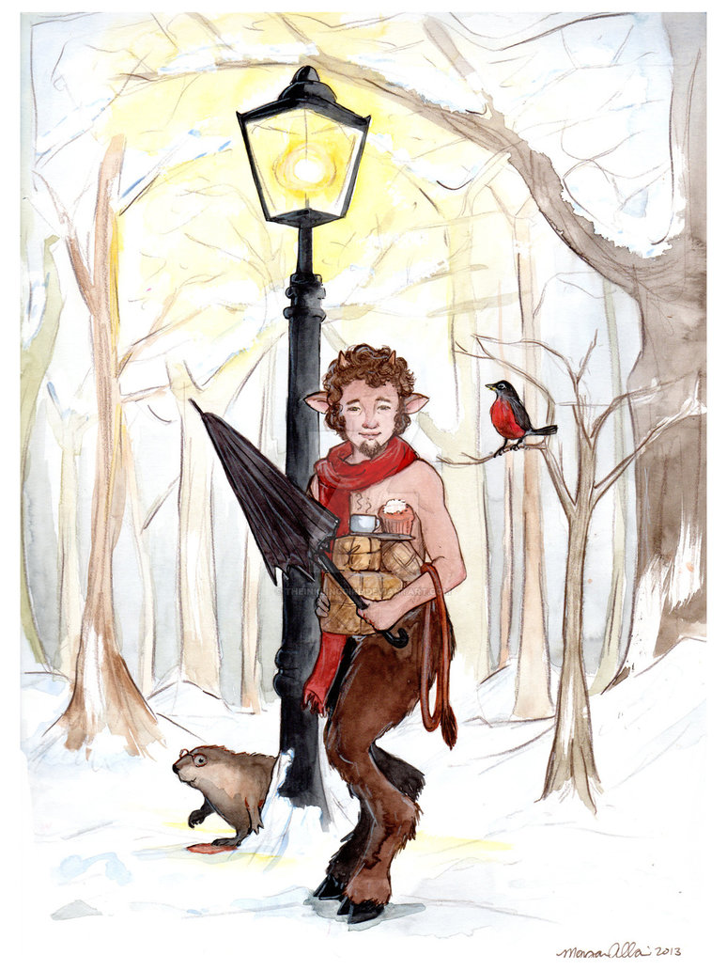
“All seven of my
Narnia books,
and my three
science fiction books, began with seeing
pictures in my head.”
-C. S. Lewis, “It all began with a Picture” . . .”

Slide 36
Principle Four:
Effective communicators
Evoke emotion

Slide 37
It is better to
get a message out of someone
than to put one in them.

Slide 38

“Never use adjectives or adverbs which are mere appeals to the reader to feel as you want him to feel. He won’t do it just because you ask him:
you’ve got to make him.”
-C. S. Lewis, “On Stories”

Slide 39
“Don’t tell us the jewels had an ‘emotional’ glitter; make us feel the emotion. I can hardly tell you how important this is.”
-C. S. Lewis, “On Stories”

Slide 40
“Evoke by surprising the reader or listener: catch people unprepared.”
-C. S. Lewis, “On Stories”

Slide 41
Word
Comparison
In media res
Story

Slide 42
“To be stories at all they must be series of events: but it must be understood that this series—the plot, as we call it—is only really a net whereby to catch something else.”
-C. S. Lewis, “On Stories”

Slide 43

Myth has the power to “sneak past watchful dragons.”
-C. S. Lewis, “Sometimes Fairy Stories May Say Best What’s to be Said”

Slide 44
Principle Five:
Effective communicators are
Audience-centered

Slide 45
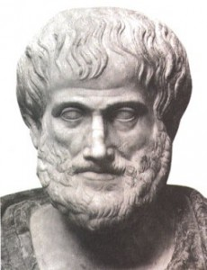
“For of the three elements in speechmaking—speaker, subject, and person addressed—
it is the last one, the hearer,
that determines the speech’s
end and object.”
-Aristotle

Slide 46
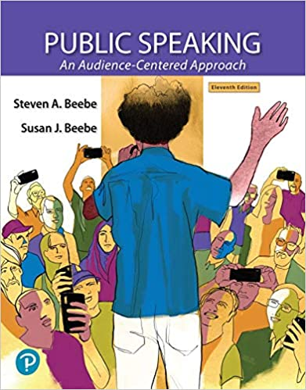
“The audience writes the speech.”
-Waldo Braden

Slide 47
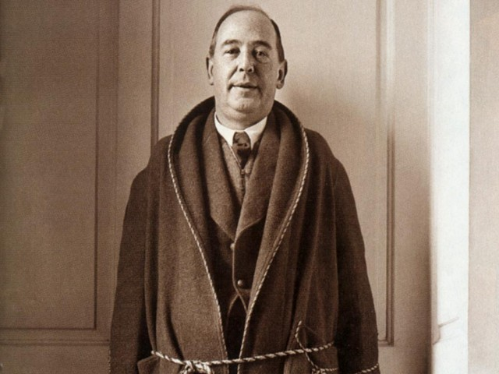
“Instead of saying, ‘How would Cicero have said that?’ You have to ask yourself, ‘How would my scout or bedmaker have said that?’”
-C. S. Lewis, God in the Dock

Slide 48

“. . . of any utterance, whether conversational or poetical, our first demand is that it must be interesting. I am afraid we cannot make it more definite than that.”
-C. S. Lewis, The Personal Heresy

Slide 49

Conversational
Verbally immediate
Audience centered

Slide 50
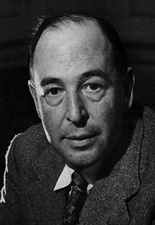
C. S. Lewis was a
Mere Communicator

Slide 51
C.S. Lewis
Popular
Professional
Professor of Communication

Slide 52
HI TEA

Slide 53
Holistic
Intentional
Transpositional
Evocative
Audience-Centered

Slide 54
Holistically: Eye/ear/reason/imagination/rhetoric/dialectic/poetic
Intentionally: With clear purpose
Transpose: Higher to lower/richer to poorer
Evoke: Get the message out of us
Audience: The most important element of communication

Slide 56
To Order Go To:
stevenabeebe.com
Use Promo Code CCSN
for 30% Discount
Valid Until June 15

