Slide 1
Understand CULTURE?
It can make
your head swim!

Slide 2
Like water to a fish
Born, raised, make life journey in CULTURE.
We “get it” by experience
  In the “hatchery”
  In the “sea”

Slide 3
We seldom talk about culture directly until . . .
. . . fish-out-of-water cross-cultural experiences
OR
. . . desire to emphasize our distinctness from another culture.

Slide 4
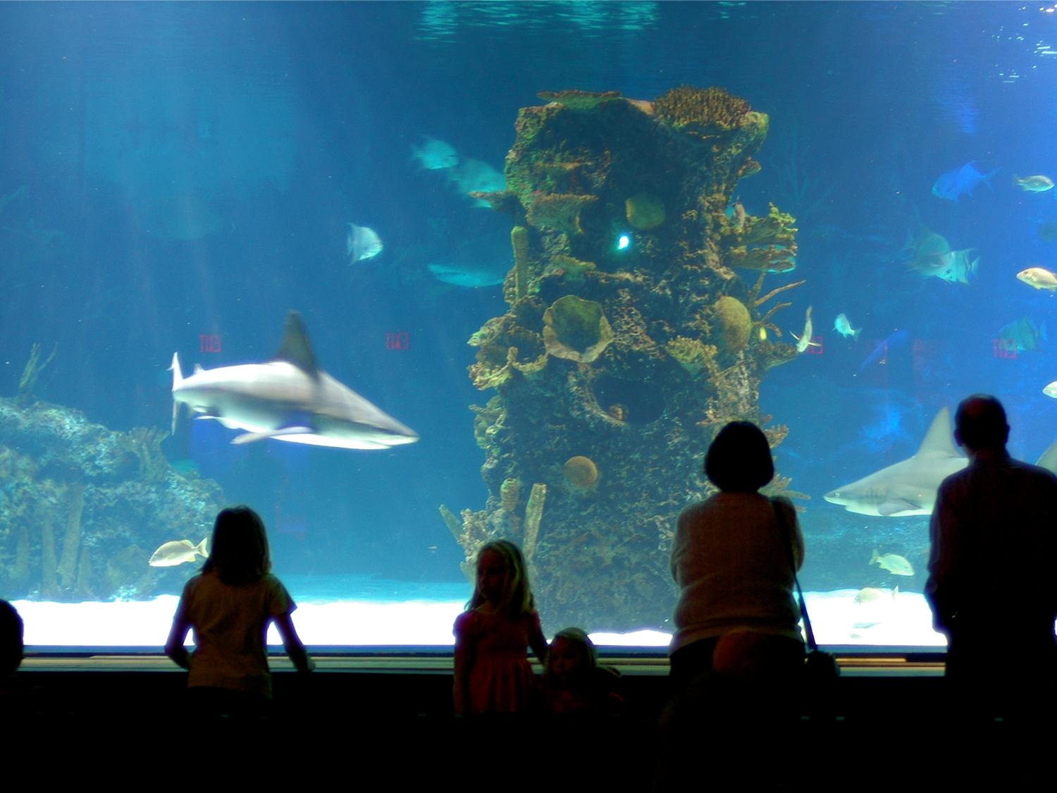
Through the looking glass
Stepping back – to take a closer look
Study of culture: Anthropology
Study of intercultural comm – since WWII

Slide 5

3 ways to view culture
Social science view: Culture is . . . a group’s learned & shared pattern of perception
Interpretive view: Culture is . . . a web of symbolic meanings shared by group
Critical view: Culture is . . . a battleground over whose meanings and values will dominate society

Slide 6
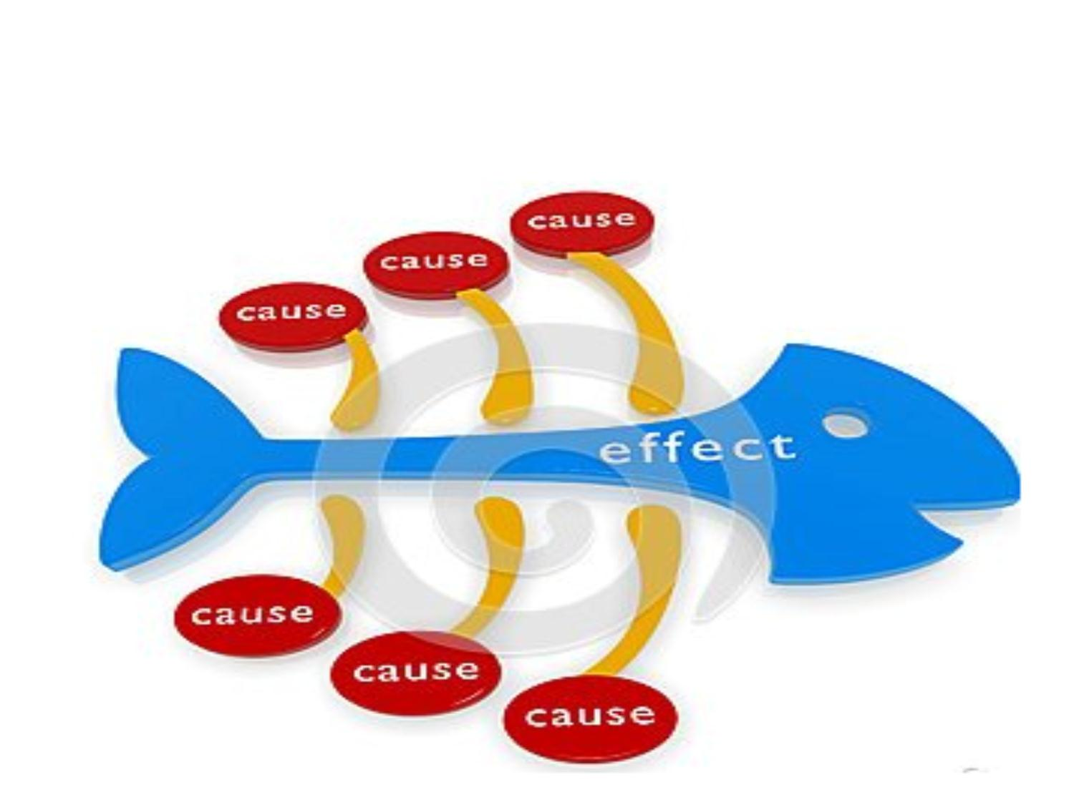
1. Social scientific view

Slide 7

1. Social scientific view
(from psychology research tradition)
Look for causes of human behavior
Culture = group’s pattern of perception
Perception partly causes behavior, so:
  Culture influences communication.

Slide 8

2. Interpretive view
(from anthropology tradition)
Goal: Insider understanding of a culture

Slide 9
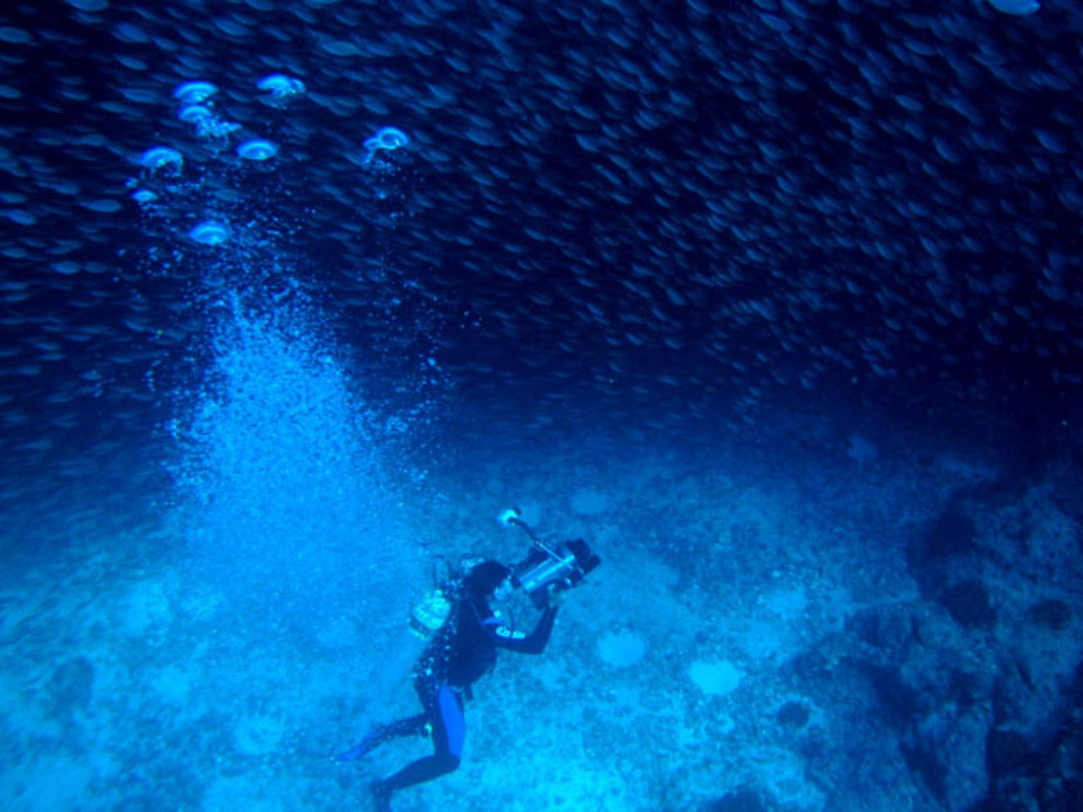
2. Interpretive view
Culture = group’s web of symbolic meanings
  MEANINGS
  SYMBOLIC
  WEB
2-way relation with behavior:
  Culture influences communication
  Communication influences culture

Slide 10
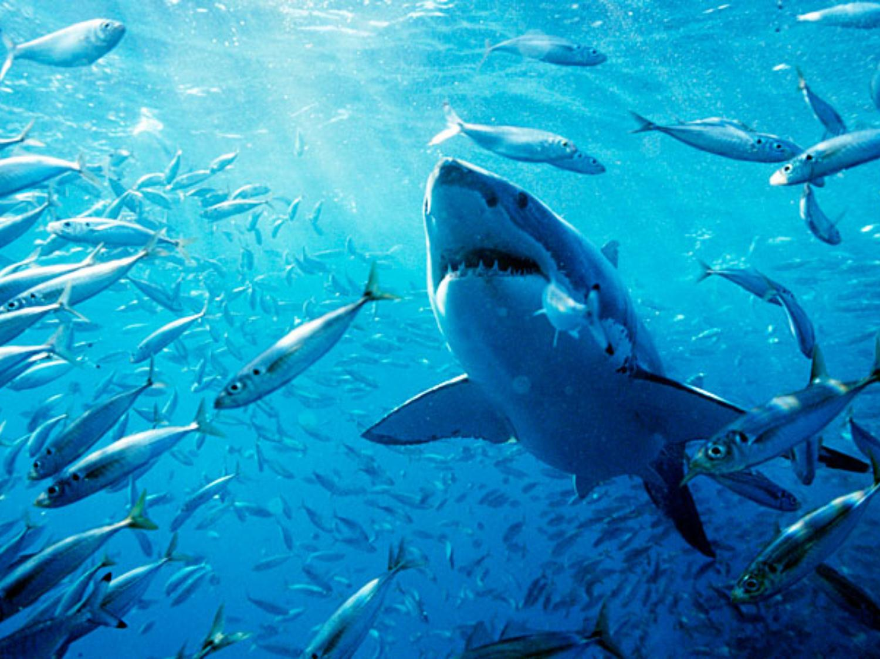
3. Critical view
(from critical-cultural studies tradition)
BEWARE OF THE
SHARKS
of culture

Slide 11
3. Critical view
Goal: critique abuses of power
Culture = a battleground
Communication forms / reforms culture

Slide 12

Connections to Eastern mission
3 windows on culture:
FAITH, REASON, JUSTICE

Slide 13
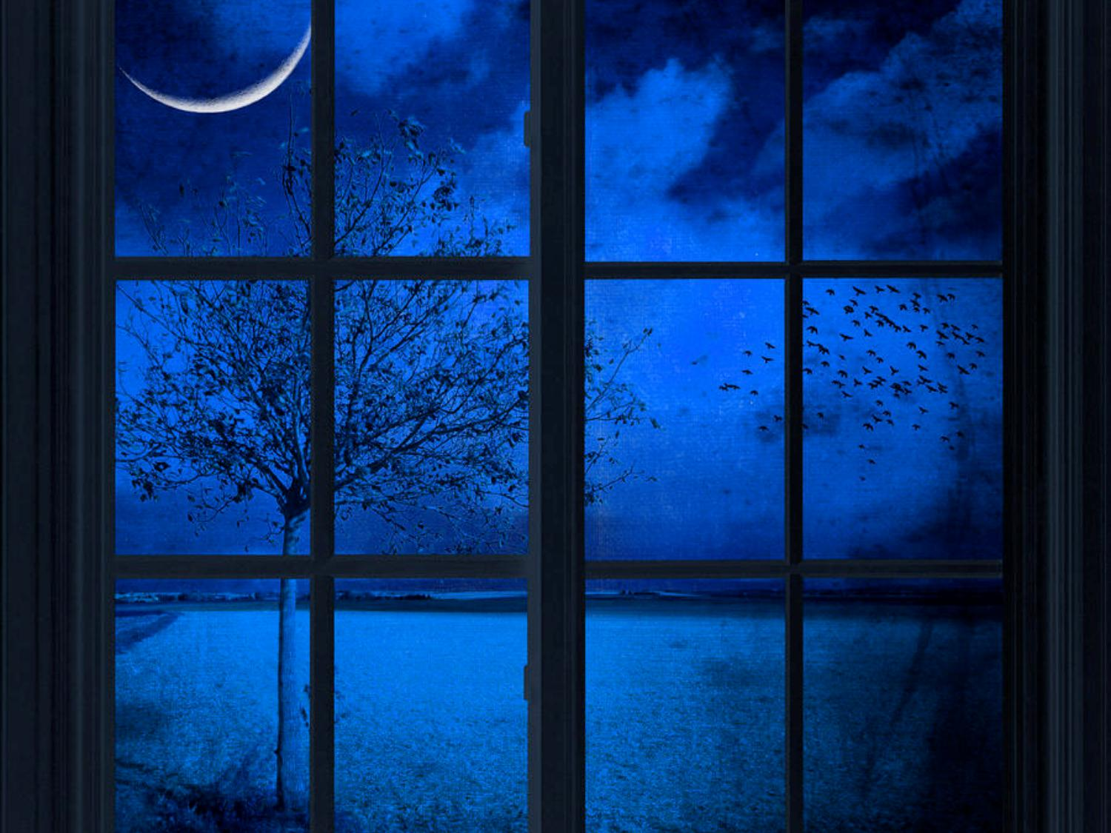
FAITH as window on culture
Interpretive view interested in a culture’s “faith” (religious or secular):
  Meaning of life
  Understanding of universe
  What is sacred
Goal: Understand and appreciate unique cultural symbols, stories, myths, creations, worldview

Slide 14
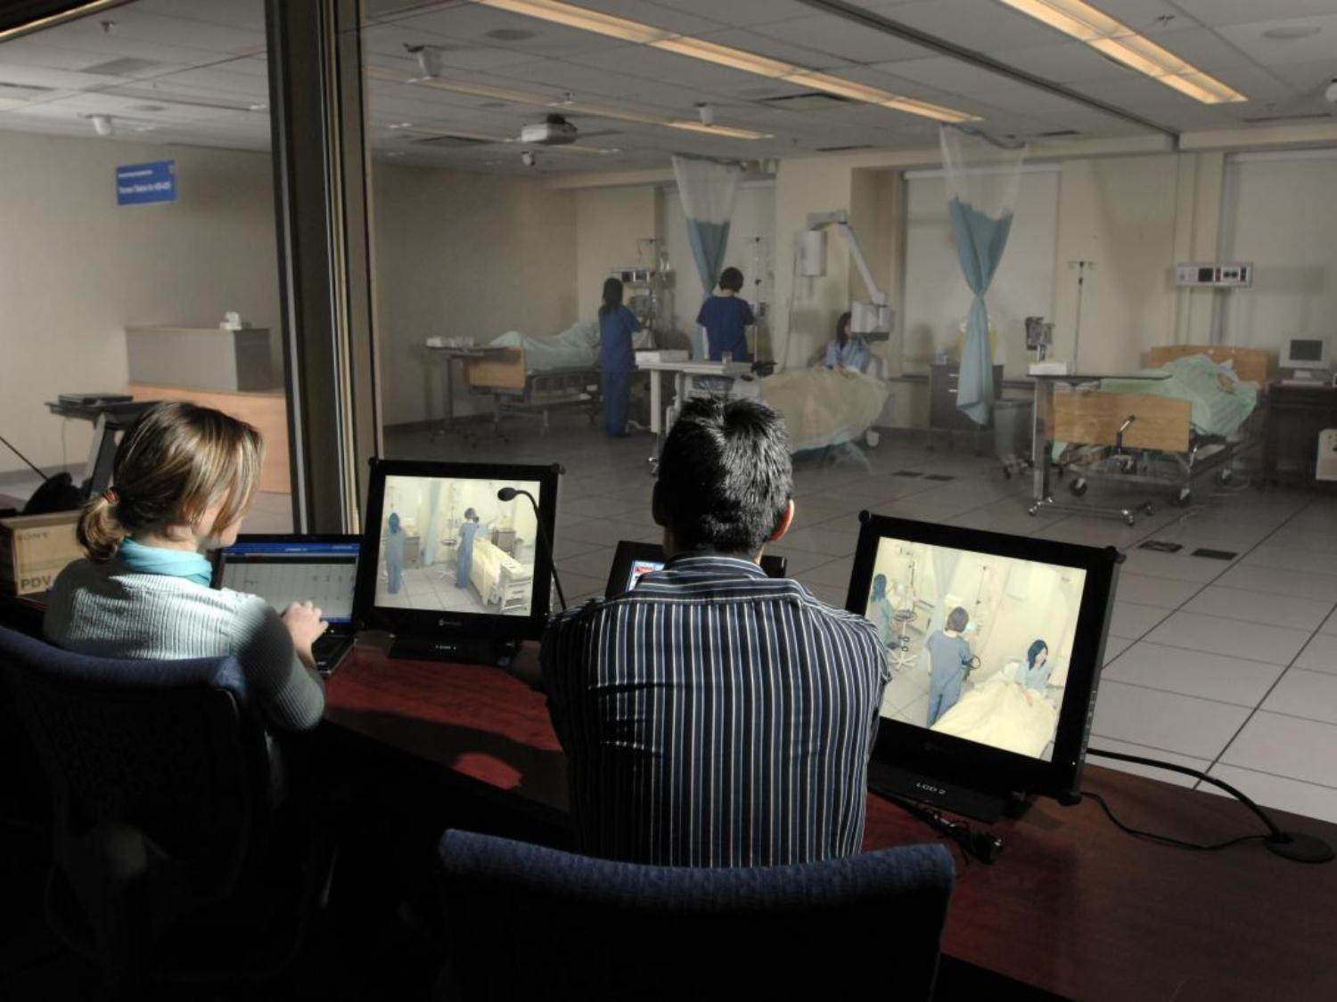
REASON as window on culture
Social-science view seeks rational, empirically tested explanations
  Human animal like a machine
  Reduce complexity to simple parts/forces
  Abstract variables
Goal: Reasoned explanation -- no mystery

Slide 15
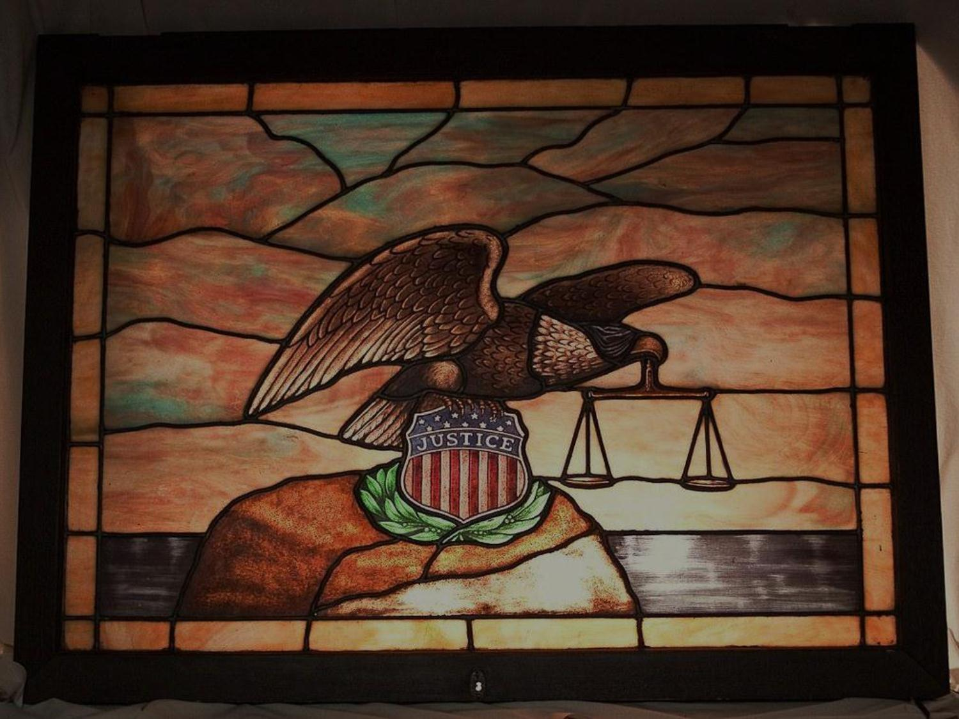
JUSTICE as window on culture
Critical view looks for cultural injustices
  Dominance over sub-groups
  Ideologies
  Norms/rules of inequality
  Hegemony
Goal: Expose injustice, empower the oppressed, promote change for justice

Slide 16

Getting the whole picture (3D)
Faith
Reason
Justice

