Slide 1
Reconciliation
Theological, Ethical, and Rhetorical Frameworks

Slide 2
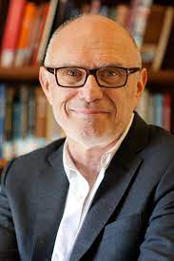
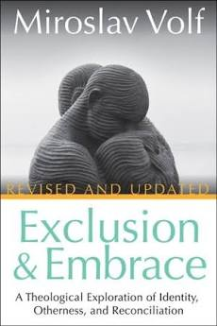
Miroslav Volf: A Theologian’s Take

Slide 3

Historical/Cultural Problem
“Unbridgeable gap created by unspeakable evil”
  Holocaust
  Genocides in Volf’s homeland (Croatia)
  Other genocides
  American Slavery
Religion as source of conflict
  When used primarily a badge of cultural identity
  Us against them
  God’s on our side!

Slide 4
Biblical Solution
NOT Cheap Reconciliation (peace without justice)
NOT “First justice, then reconciliation”
  “Impossible” (p. 73)
  “Would not really bring people together” (p. 74)
  “Undesirable” (p. 74)
INSTEAD: Way of the cross
  God’s grace shown to evildoers
  Justice transformed
  Bridges the unbridgeable gap

Slide 5
Volf’s Theology of Reconciliation
Four implications
Will to embrace is unconditional
  (Reflection of divine grace)
Truth and justice are preconditions of actual embrace
Will to embrace is framework of search for truth and justice
Embrace is horizon of struggle for justice.
  (Restored peace in relationship)

Slide 6
WILL TO
EMBRACE
(Grace))
JUSTICE
TRUTH
ACTUAL EMBRACE
(Peace)

Slide 7
Speaking to Reconciliation
(Hatch, 2020)
What is reconciliation?
Why do many leaders draw on religious traditions when speaking to reconciliation?
What are some major values that reconciliation must grapple with if it is to bring genuine healing between groups?
(From pp. 20-22):
  Why are most of the speeches in the book connected with Christian faith instead of other religions?
  Why aren't there more women's voices in the book?
What’s one question you have about this book so far?

Slide 8
Hatch’s Frameworks*
Tetrad: Set of 4 intrinsically connected items
Ethical tetrad: 4 interconnected values
Rhetorical tetrad: 4 ways of framing social conflict,
each oriented by one of those values
Dialogic rhetorical process: Reconciling inter-actions
*From Speaking to Reconciliation (Hatch, 2020), pp. 5-19.

Slide 9
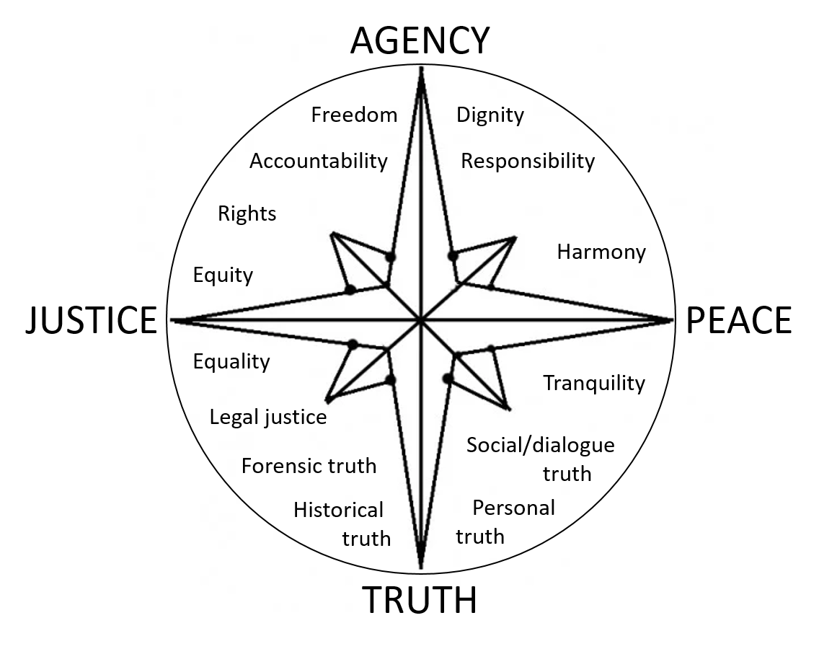
Oriented by Values

Slide 10
Tetrad – Core Values
AGENCY
TRUTH
JUSTICE
PEACE

Slide 11
Moral Brokenness:
Isolated values in conflict
AGENCY
Violence
TRUTH
Oppression
JUSTICE
PEACE

Slide 12
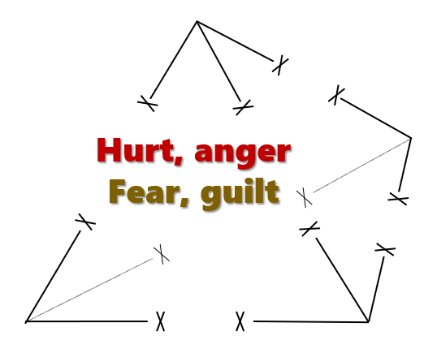
Aftermath: Conflicting Moral Frames
ROMANTIC
FRAME
Views
situation from
AGENCY angle
Views
situation from
TRUTH angle
REALISTIC
FRAME
Views
situation from
JUSTICE angle
Views
relationship
from PEACE angle
TRAGIC
COMIC
FRAME
FRAME

Slide 13
Victim Perspective: Anger, Resentment
(Justice angle -- Tragic frame)
AGENCY
TRUTH
JUSTICE
PEACE
TRAGIC
FRAME

Slide 14
Forgiveness as REFRAMING toward wholeness

Slide 15
REACH model of forgiveness*
Recall the hurt (TRUTH angle – Realistic frame)
  Within safe environment
Empathize with offender (PEACE angle – Comic frame)
Altruistic gift – (GRACE angle – Romantic frame)
  Guilt – recognize your own faults
  Gratitude (for forgiveness you’ve received)
  GIVE grace
Commit to forgive (make it public)
Hold on to forgiveness

Slide 16
1. Recall the hurt
(within safe environment)
AGENCY
REALISTIC
FRAME
TRUTH
JUSTICE
PEACE

Slide 17
2. Empathize with offender
AGENCY
TRUTH
JUSTICE
PEACE
COMIC
FRAME

Slide 18
Toward Complexity and Wholeness
AGENCY
REALISTIC
TRUTH
FRAME
Restorative
Justice
JUSTICE
PEACE
TRAGIC
COMIC
FRAME
FRAME

Slide 19
3. Altruistic gift of forgiveness
ROMANTIC
FRAME
AGENCY
TRUTH
JUSTICE
PEACE

Slide 20
Offenders’ Repentance as Reframing
Offending party may start from . . .
  Romantic frame
    Often focused on victims’ agency to transcend/forgive
    Not taking responsibility for damage from past
    Myth of unlimited opportunity
  Comic frame
    Emphasize common humanity (not victimizer/victim distinction
    Emphasize shared guilt (e.g. “We’re all sinners”)
    “Color-blind”
Need to take realistic view of history
Need to look through victims’ eyes: tragic

Slide 21
ROMANTIC
FRAME
AGENCY
REALISTIC
GRACE
TRUTH
FRAME
Restorative
Justice
JUSTICE
PEACE
TRAGIC
FRAME
COMIC
FRAME
Wholeness in Repentance/Forgiveness

Slide 22
Reconciling Values:
Restoring Moral Coherence
AGENCY
*Mercy – loose synonym
for grace
TRUTH
Grace*
Restorative
Truth
Restorative
Justice
Shalom
JUSTICE
PEACE

Slide 23
Biblical Basis
A vision of humanity restored by God:
“Mercy and truth have met together.
Justice and peace have kissed!”
(Psalm 85:10, The Living Bible)

Slide 24
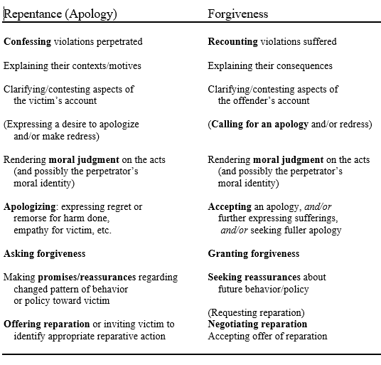
Inter-Actions of Repentance & Forgiveness

Slide 25
GRACE
(Will to embrace)
Will to repent
Will to forgive
Confess
wrongdoing
Recount
suffering
Render
moral judgment
Offer apology
Respond
to apology
TRUTH/
JUSTICE
TRUTH/
JUSTICE
Negotiate apology
and reparation
Ask forgiveness
Grant forgiveness
Ongoing repair
PEACE
(Actual embrace)

Slide 26
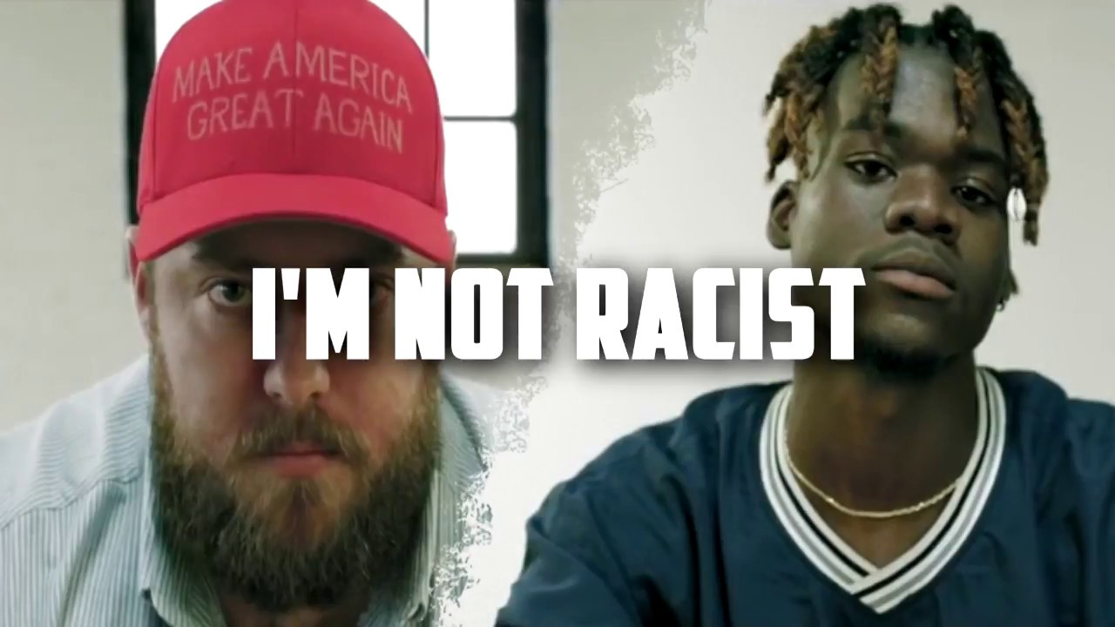
Modeling Racial Reconciliation:
A Musical Attempt
(by Joyner Lucas)
From rage to embrace!
But . . . does this measure up to Volf’s model?

